Slide 1

Making the Solar Suitcase Academically Effective

Slide 2
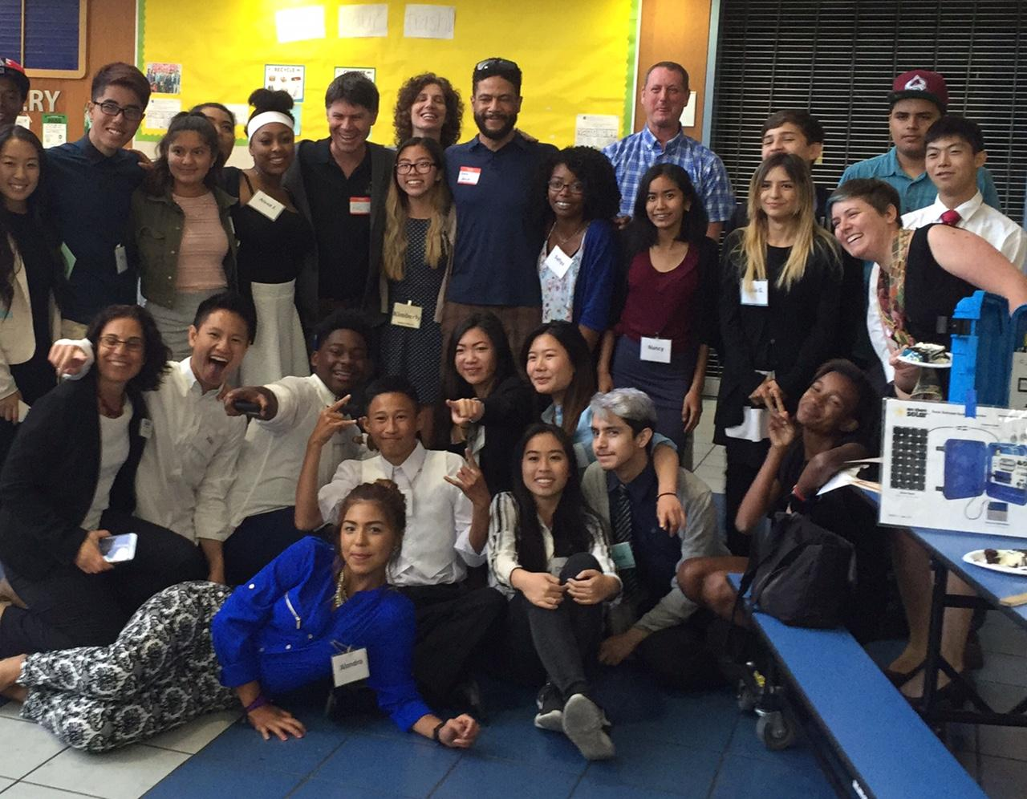
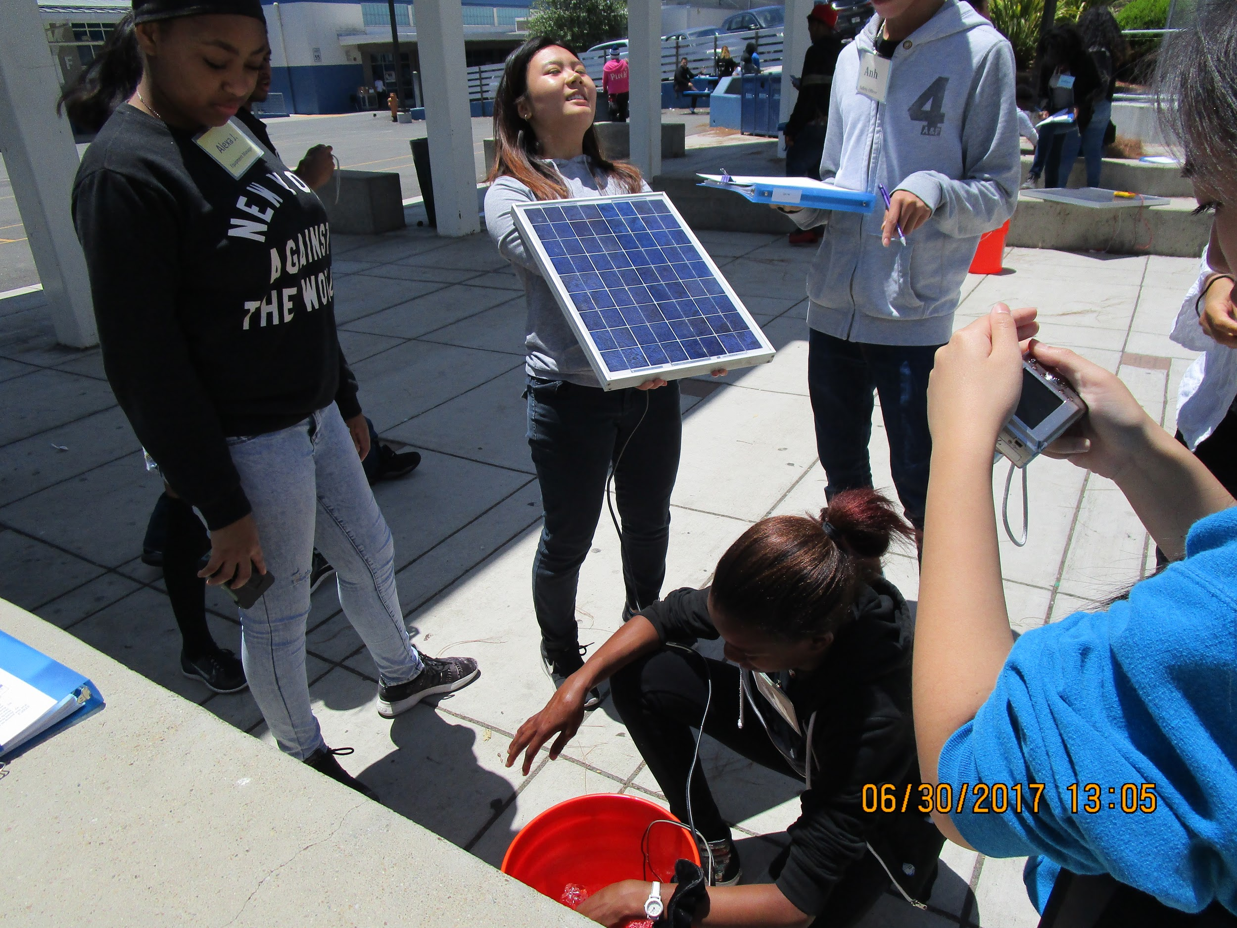
Teaching the WSS Curriculum
Anna Gomberg, OUSD, EPICC
Making cultural connections
and providing context
Using prompts and structured student discussion
Modeling
Assessment
Notes:
Explain context (3 week summer program)

Slide 3
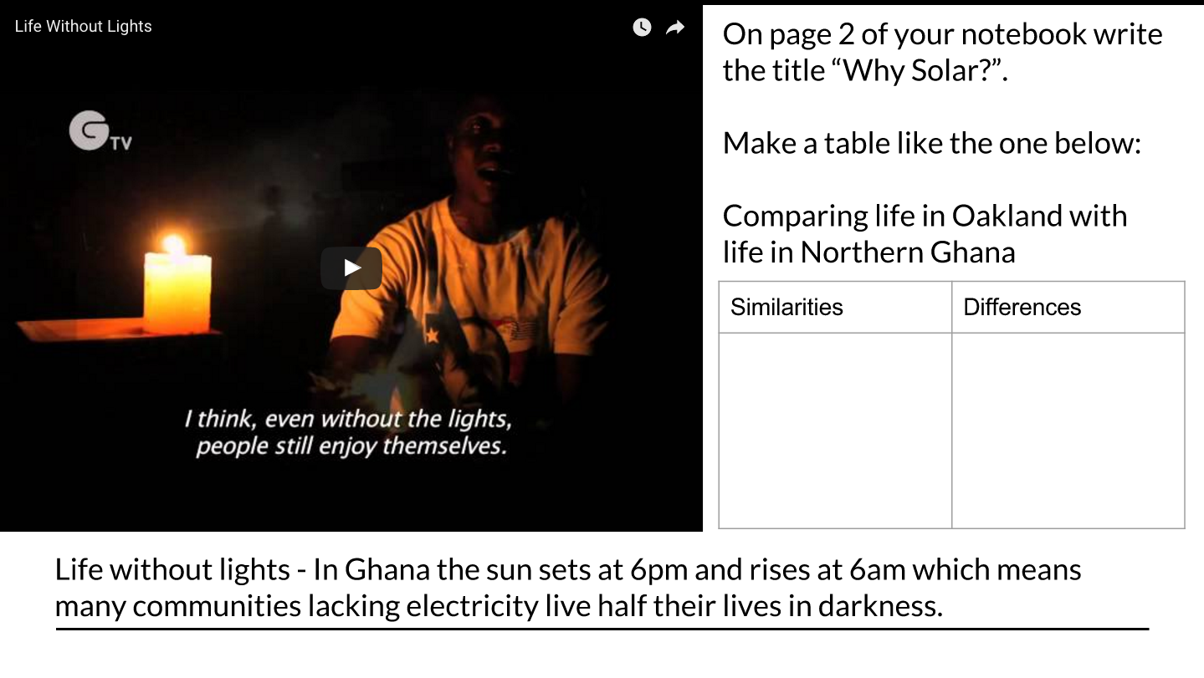
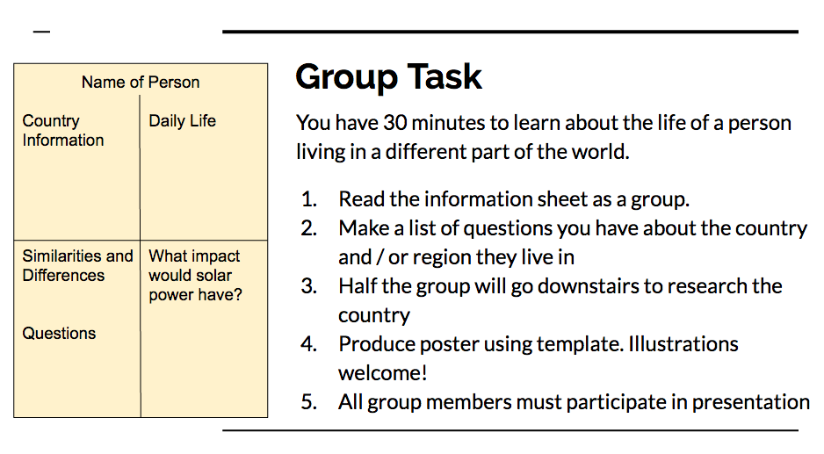
Making Cultural Connections and Providing Context
Comparing lifestyles and challenges
Notes:
Importance of seeing people who are receiving the suitcases as equals.

Slide 4
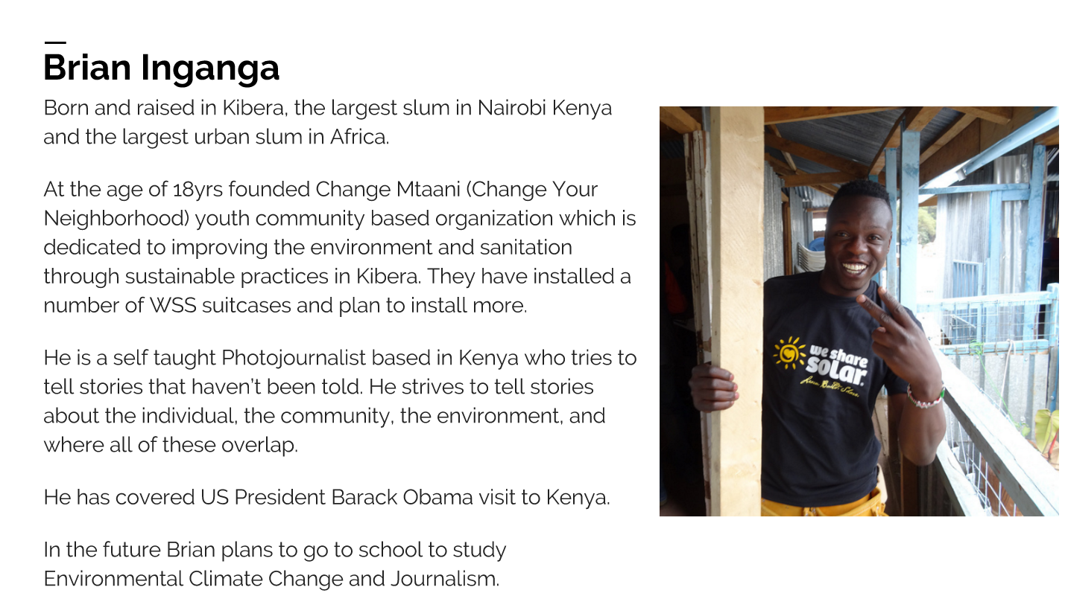
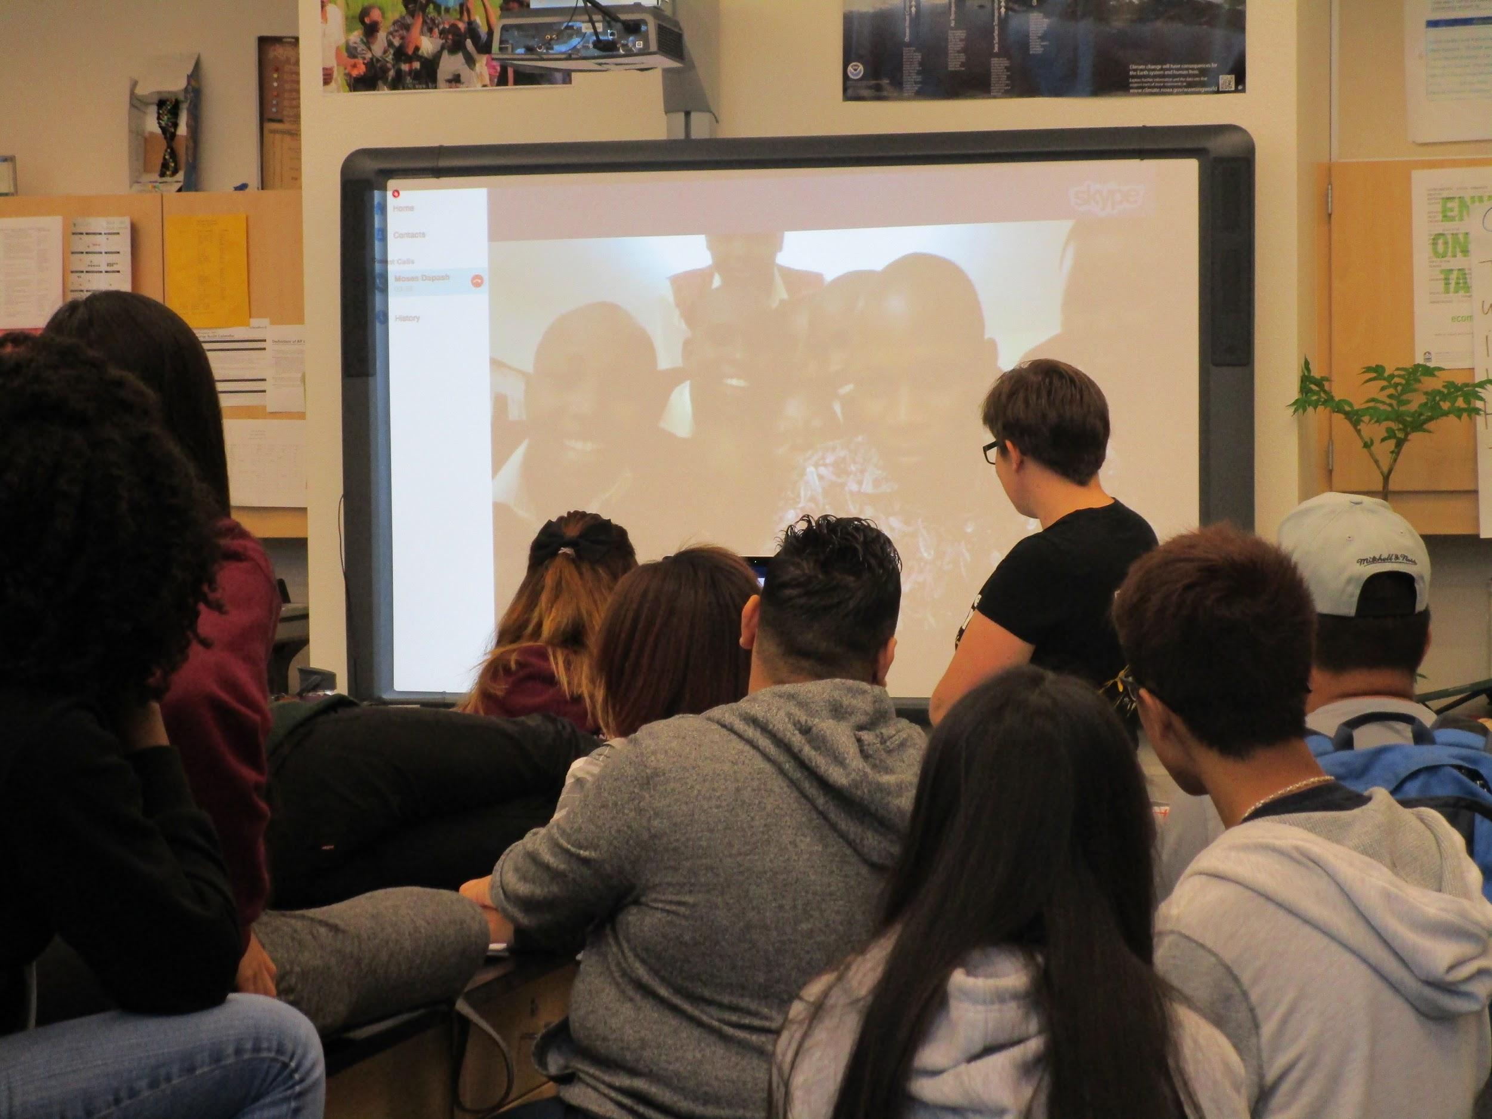
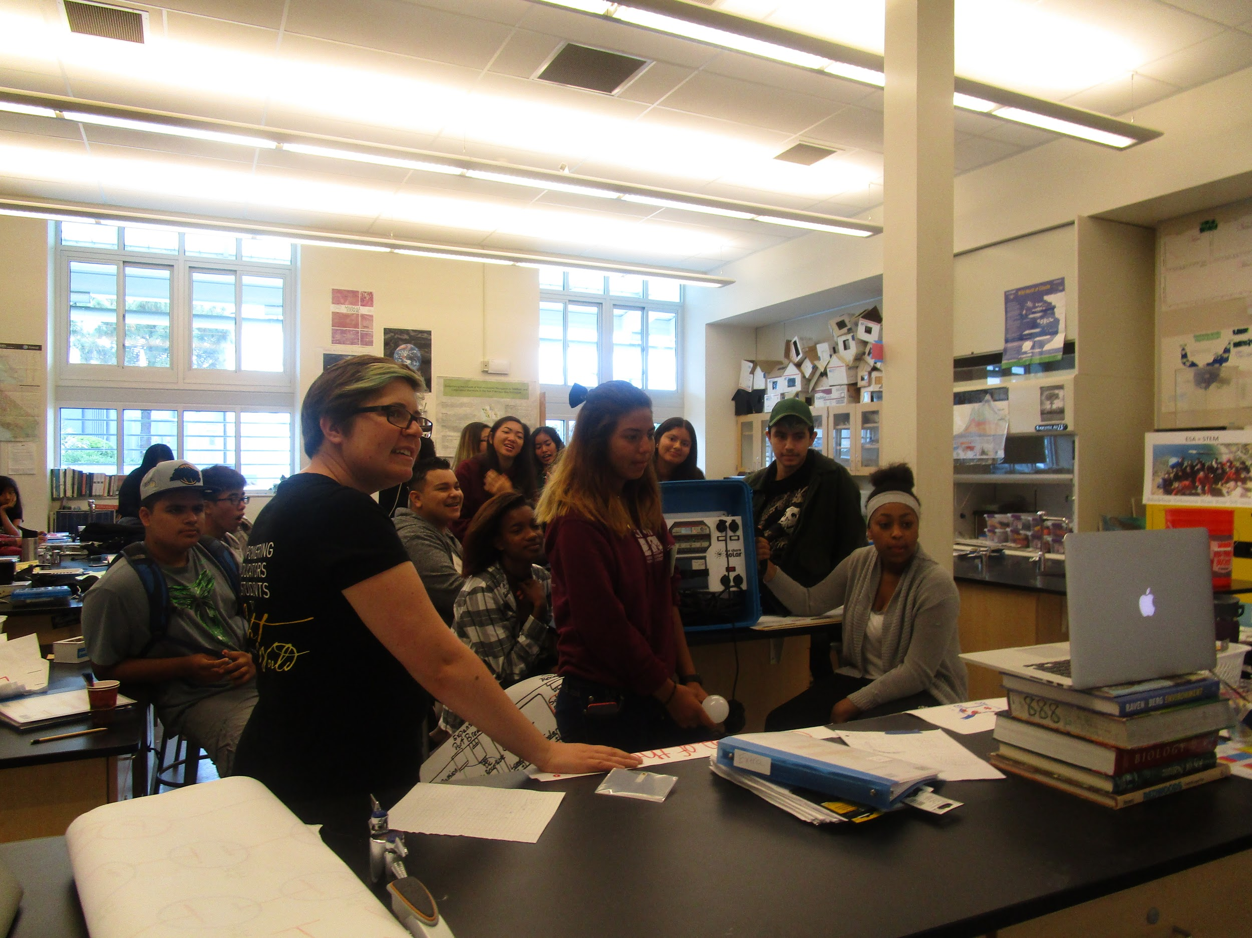
Making Cultural Connections and Providing Context
Skyping with Kenya
Notes:
Emphasise this! Huge impact if it can be done - support from WSS and all parties were THRILLED to skype

Slide 5

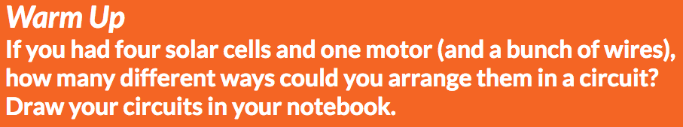
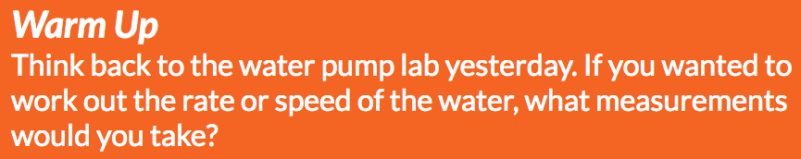

2. Using prompts and structured student academic discussion
Notes:
Confidence building; equity (sticks); support for ELL; misconceptions come to light

Slide 6



2. Using prompts and structured student academic discussion

Slide 7
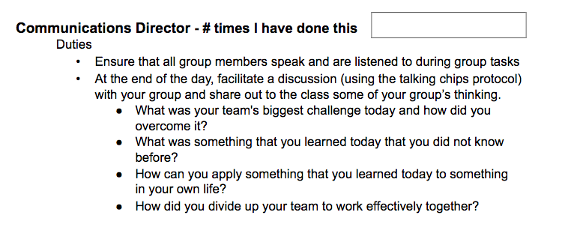
2. Using prompts and structured student academic discussion
Notes:
Communication skills

Slide 8
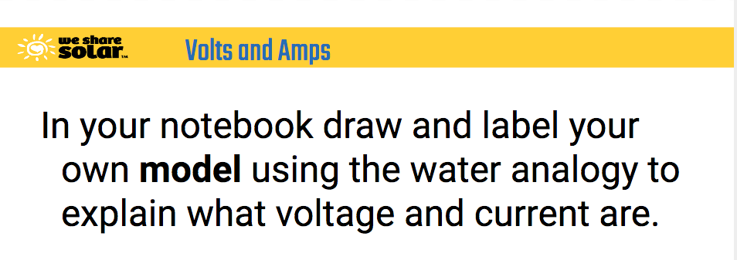
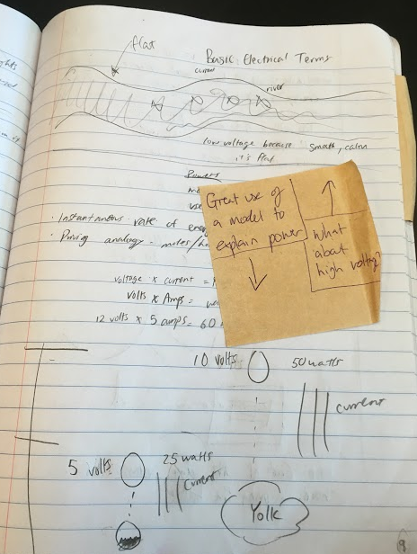
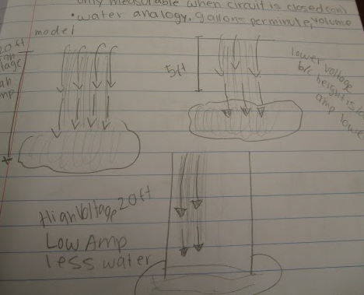
3. Modeling
Notes:
NGSS SEP #2: Developing and using models. Good opportunity for formative feedback; helpful for clarifying concepts / cementing them.

Slide 9

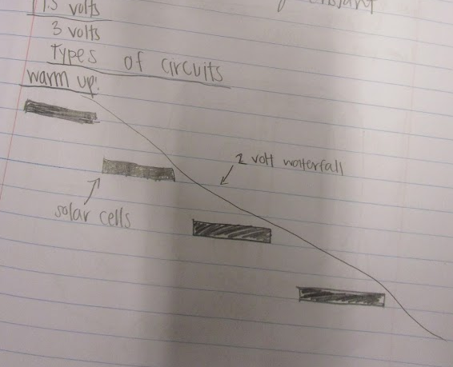
3. Modeling

Slide 10
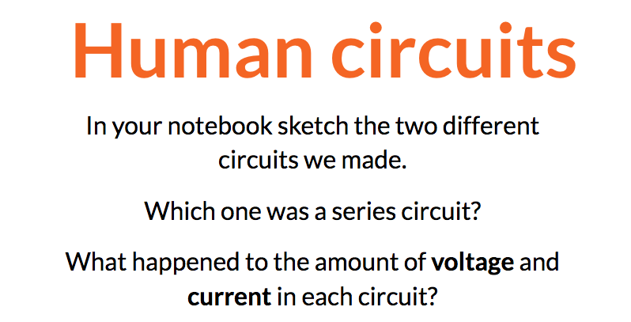
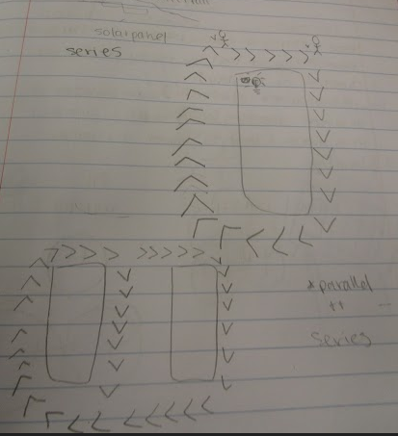
3. Modeling

Slide 11
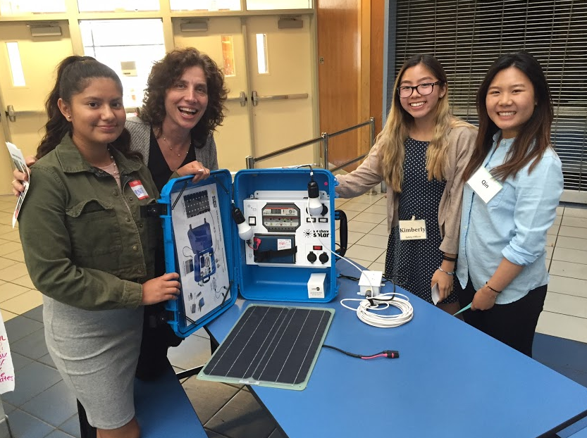
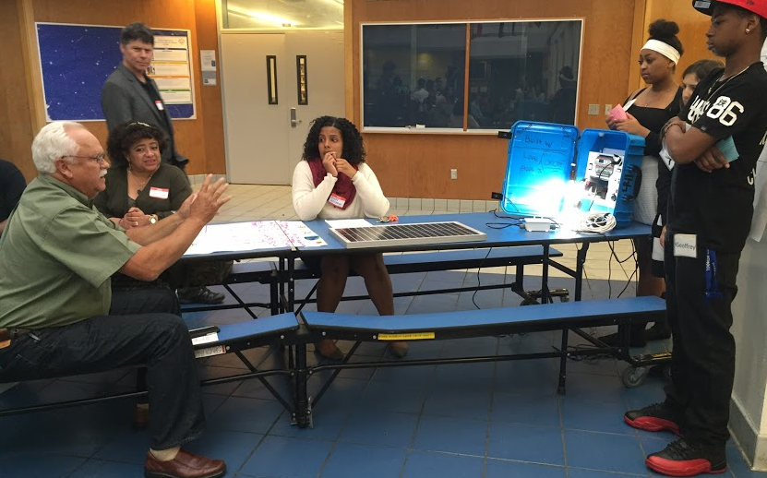
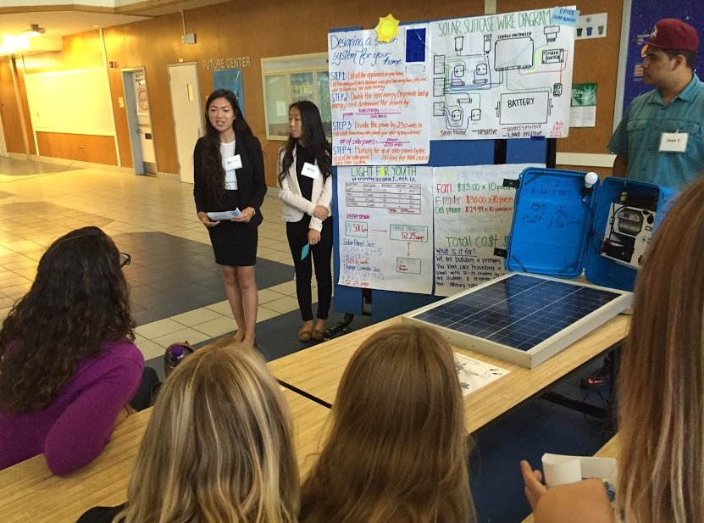
4. Assessment
Notes:
Demonstration of understanding is vital to help students retain knowledge - assessments were verbal and written. Focus on communication skills and group work encouraged students to assess each other

Slide 12
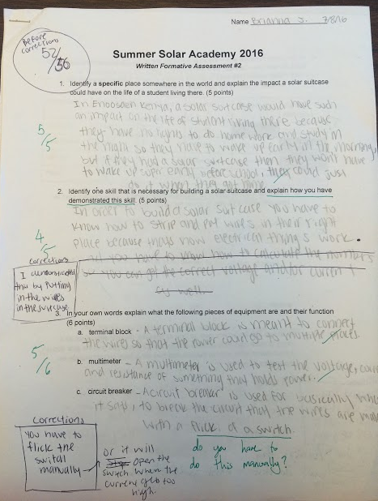
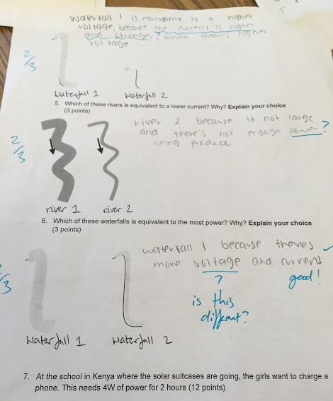
4. Assessment
Notes:
Formative and summative feedback

Slide 13
Comments and Questions?
Anna Gomberg, OUSD, EPICC anna.gomberg@ousd.org

