Slide 1

LESSON PLAN FLOW & ACTIVITIES
PG&E Professional Development Workshop
2015

Slide 2
Three Week Course – Major Topics
Basic Electricity
Wiring Diagram
Solar Electric System Design
Global Energy Access
Tool Skills
Solar Suitcase Assembly & Commissioning
Data Logging &Troubleshooting
Sizing Solar Electric Systems
Presentation and Communication Skills

Slide 3
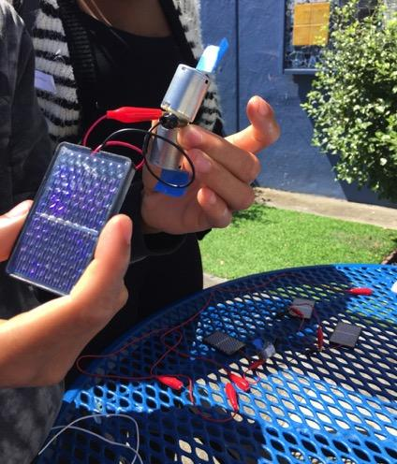
I. Exploration with Solar Cells
  Provide small cells and motors
  Open building exploration
  PV Effect: shading, angle
Solar Cells & Motors
  Experiment with wiring both types
  Series Adds Voltage (SAV)
  Parallel Adds Amps (PAA)
Series and Parallel
  Students teach wiring
  Build circuits to match specific loads
  Water pumping race
Practice and Competition

Slide 4
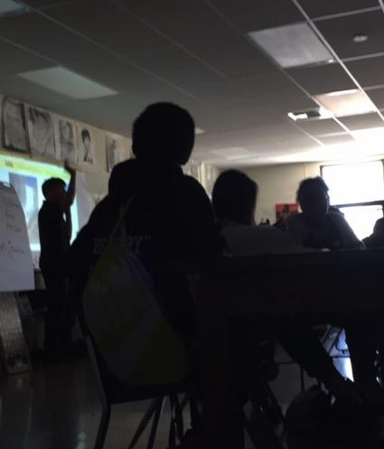
II. Global Energy Access
  Explaining energy access
  Showing places experiencing energy poverty
  Videos: vimeo.com/tag:energy+poverty
Videos
  Students try to read in the dark
  Discussion: why do we need electricity?
  Dangers of Kerosene
Lesson in the Dark
  Handouts about students living in energy poverty
  Jigsaw activity: students share stories with one another
Solar Stories
  How is it a solution?
  Where are the suitcases going and who are they helping?
Solar Suitcase

Slide 5
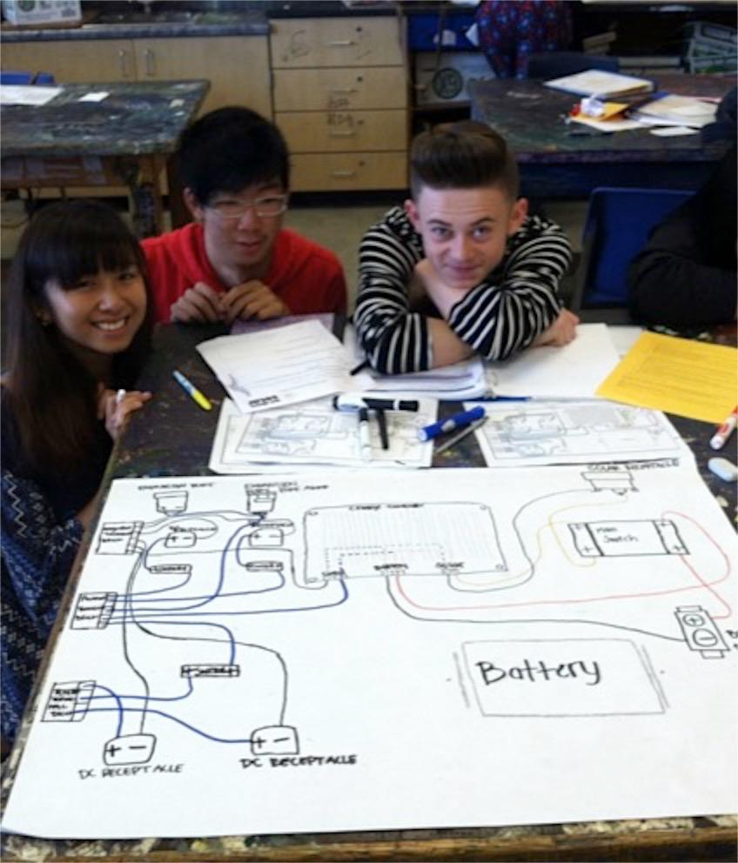
III. Solar Electric System Design
  Overview of the system
Stand-Alone System
  Simplify circuit: solar charging circuit, load powering circuit
  Components
Wiring Diagram

Slide 6
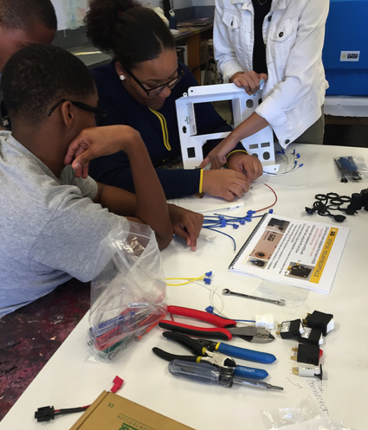
IV. Solar Suitcase Assembly &
Commissioning
  Color solar suitcase wiring diagram
  Students explain flow of electricity
Wiring
  Practice wiring terminal blocks
  Inventory parts
  Building tips
  Suitcase assembly
Assembly &Tool Skills
  Importance of quality control
  Using a DMM for continuity testing
  Complete commissioning procedure
Commissioning
  Students write letters to suitcase recipients
Letters

Slide 7
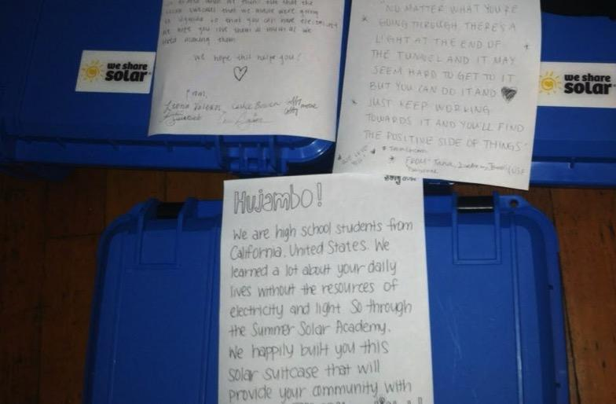
V. Writing Letters to Recipients

Slide 8
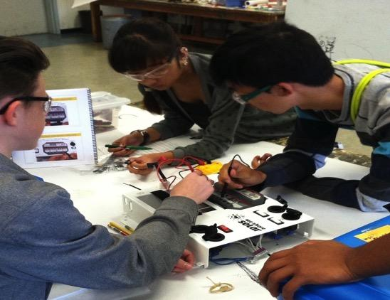
VI. Data-logging & Troubleshooting
  Interpreting charge controller display
  Practice scenarios
Charge Controller
  Record solar amp, battery voltage, and load amp measurements
  How do the three measurements relate to one another?
Data-logging
  Using DMM to diagnose
  Stations with different scenarios
Troubleshooting

Slide 9
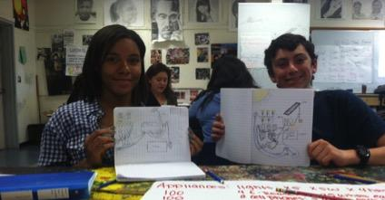
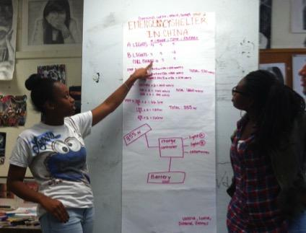
VII. System Sizing
  Sizing for different loads & geographic locations
Loads
  Choosing system components
  Calculating system cost
Components
  Draw single line diagram
  Share system with the class
Sharing

Slide 10
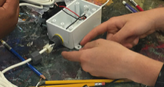
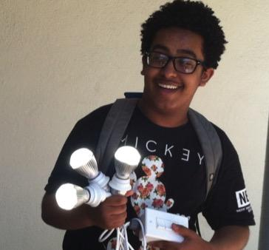
VIII. Light Switch Boxes
  Students color code wiring diagram
  Demonstrate how switches work
Wiring Diagram
  Build switch box
Assembly
  Quality control
  Energize: connect to solar suitcase
Commissioning

Slide 11
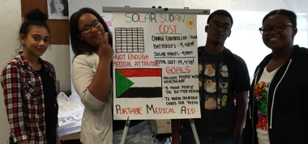
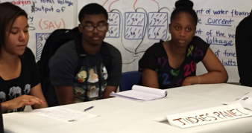
IX. Shark Tank
  What is included in a pitch
Discussion
  Design full system
  Draw double and single line diagram
Design
  Students make their “pitch”
  Student judging panel
Presentation

Slide 12
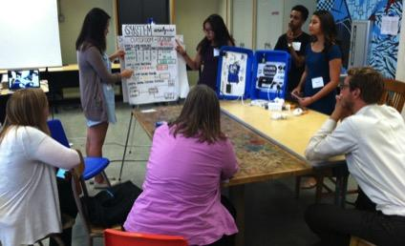
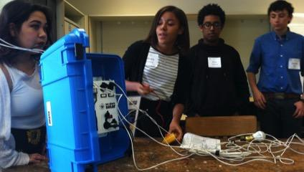
X. Wrapping Up
  Review questions
  System sizing practice
Final Exam Review
  Prepare presentations for community members
  Outline and talking points
Presentation Prep
  Students present to guests
Presentations

Slide 13
THE END!

