Slide 1
Notes for use of this document
This document contains everything that was displayed for students during the solar and math portions of a three week summer academy. There are also teacher notes included.
I hope that this is useful for others teaching the We Share Solar Curriculum.
Please take slides as needed. If you have any questions please do not hesitate to contact me.
Anna Gomberg
OUSD
anna.gomberg@ousd.org

Slide 2
EPICC Summer Solar Academy 2016
Oakland Unified School District
We Share Solar
East Bay College Fund
Aspire Education Project
Lawrence Hall of Science
UC Berkeley

Slide 3
Day 1
8.15 - 8.30: Arrival and Breakfast
8.30 - 10.15: Introductions and logistics
10.15 - 10.30: Break
10.30 - 12.00: Why Solar?
12.00 - 12.30: Lunch
12.30 - 2.00: Group roles, tools and
Lab 1: Solar Exploration
2.00 - 2.15: Inventory and group reflection
2.15 - 2.30: Break
2.30 - 3.15: College and Career
3.15 - 3.30: Closing reflections
Monday June 27
Community Building
Energy Poverty
Group roles
Introduction to your toolbox
Introduction to Solar

Slide 4
Why Solar?
Monday June 27th 2016
Learning Target:
To be able to explain why providing electricity using solar power is beneficial to people around the world

Slide 5
Why Solar? Teacher Notes
10.30 - Instruct students to go to college and career room with their notebooks and binders, sit in their groups when they get there and follow instructions on the board. NO LIGHTS other than a few flashlights / headlamps / small solar lanterns.
Instructions:
On page 1 of your notebook write the title “Solar Resource Page”. Include this in your table of contents.
In your binder find the Solar Suitcase Competency Checklist, then find the Presentation Skills section. Read out one line each, taking turns. Discuss your confidence level for these skills.

Slide 6
Why Solar? Teacher Notes
10.45 - Stop students in their tasks.
Lead discussion on the following:
What was it like following instructions in the dark?
What effect would it have to do this every day?
Why did we start out the session like this?
10.50 - Back upstairs, watch “Life without lights” then discuss similarities / differences.

Slide 7
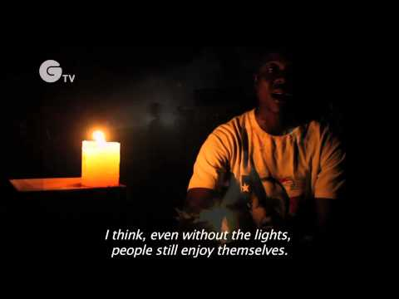
On page 2 of your notebook write the title “Why Solar?”.
Make a table like the one below:
Comparing life in Oakland with life in Northern Ghana
Similarities | Differences
Life without lights - In Ghana the sun sets at 6pm and rises at 6am which means many communities lacking electricity live half their lives in darkness.

Slide 8
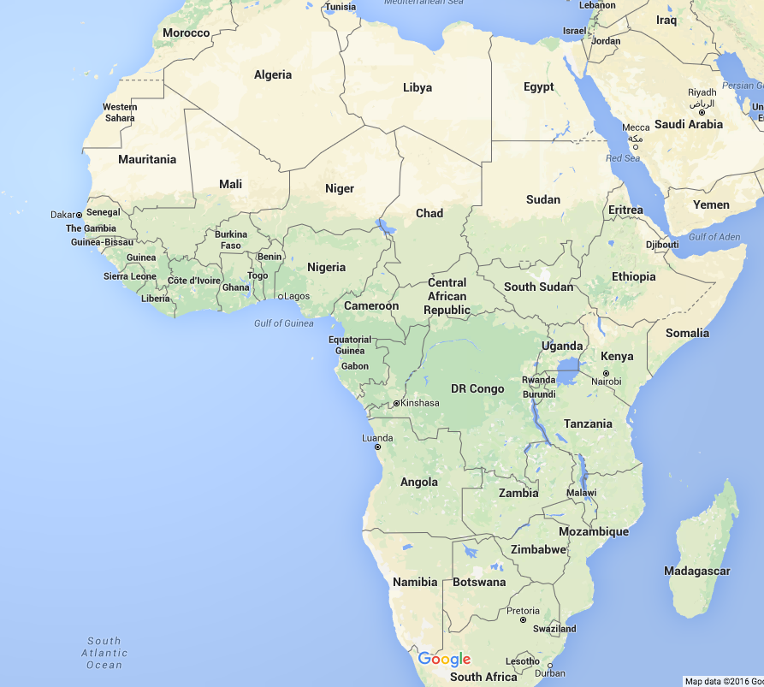

Slide 9
Why Solar? Teacher Notes
11 - Introduce task on following slide
11.10 - Accompany half of class to computers
11.25 - All students back in classroom
11.40 - Students take turns to present
If time - lead reflective discussion; what was something interesting you learned from another group?
12 - Lunch!

Slide 10
Group Task
Name of Person
Country Daily Life
Information
Similarities and What impact
Differences would solar
power have?
Questions
You have 30 minutes to learn about the life of a person living in a different part of the world.
Read the information sheet as a group.
Make a list of questions you have about the country and / or region they live in
Half the group will go downstairs to research the country
Produce poster using template. Illustrations welcome!
All group members must participate in presentation

Slide 11
Hands on session - Teacher Notes
12.30 - Solar Suitcase Competency Checklist
12.40 - A few students share out
12.45 - Meet the toolbox, practice inventory
1.00 - Team roles
1.10 - Solar Exploration Lab
1.40 - Back inside, students draw and present circuits
2.00 - Tools inventory
2.05 - Group reflection
2.10 - Share out

Slide 12
Solar Suitcase Competency Checklist
Find the “Solar Suitcase Competency Checklist” in your binder.
In the day 1 column record your confidence level for each item
5 = very confident 1 = not confident at all

Slide 13
Lab 1: Solar Exploration

Slide 14
Day 2
8.15 - 8.30: Arrival and Breakfast
8.30 - 9.15: Community building
9.15 - 10.15: Solar engineering prep - Kerosene vs. Solar
10.15 - 10.30: Break
10.30 - 12.00: Basic electricity, using a multimeter
12.00 - 12.30: Lunch
12.30 - 1.15: Lab 2: The PV Effect
1.15- 2.15: Different College Systems
2.15 - 2.30: Break
2.30 - 3.15: Different College Systems
3.15 - 3.30: Closing reflections
Tuesday June 28
Community Building
Kerosene vs. Solar
Basic Electricity
Using a multimeter
The PV Effect
Different College Systems

Slide 15
Engineering Prep Kerosene vs Solar - Teacher Notes
9.15 - Warm Up and share out
9.20 - Kerosene clip and discussion
9.25 - Demo 1st problem
9.30 - Students work in groups
10.05 - One student demos question 6 (or furthest they have got to )
10.15 - Break

Slide 16
Kerosene vs Solar
Tuesday June 28th 2016
Learning Target:
To be able to compare the use of kerosene and solar power to produce light
Warm Up:
If people don’t have electricity, what do they use for light? What are some benefits and disadvantages of this light source? Write your ideas in your notebook.

Slide 17
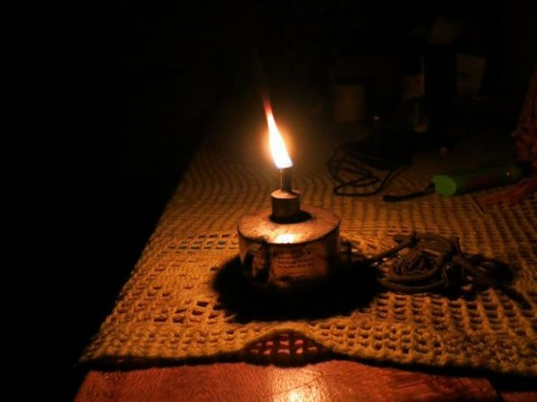
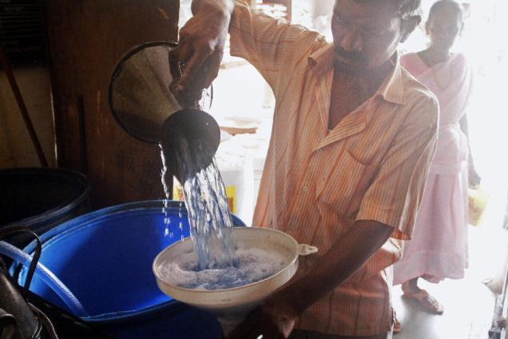
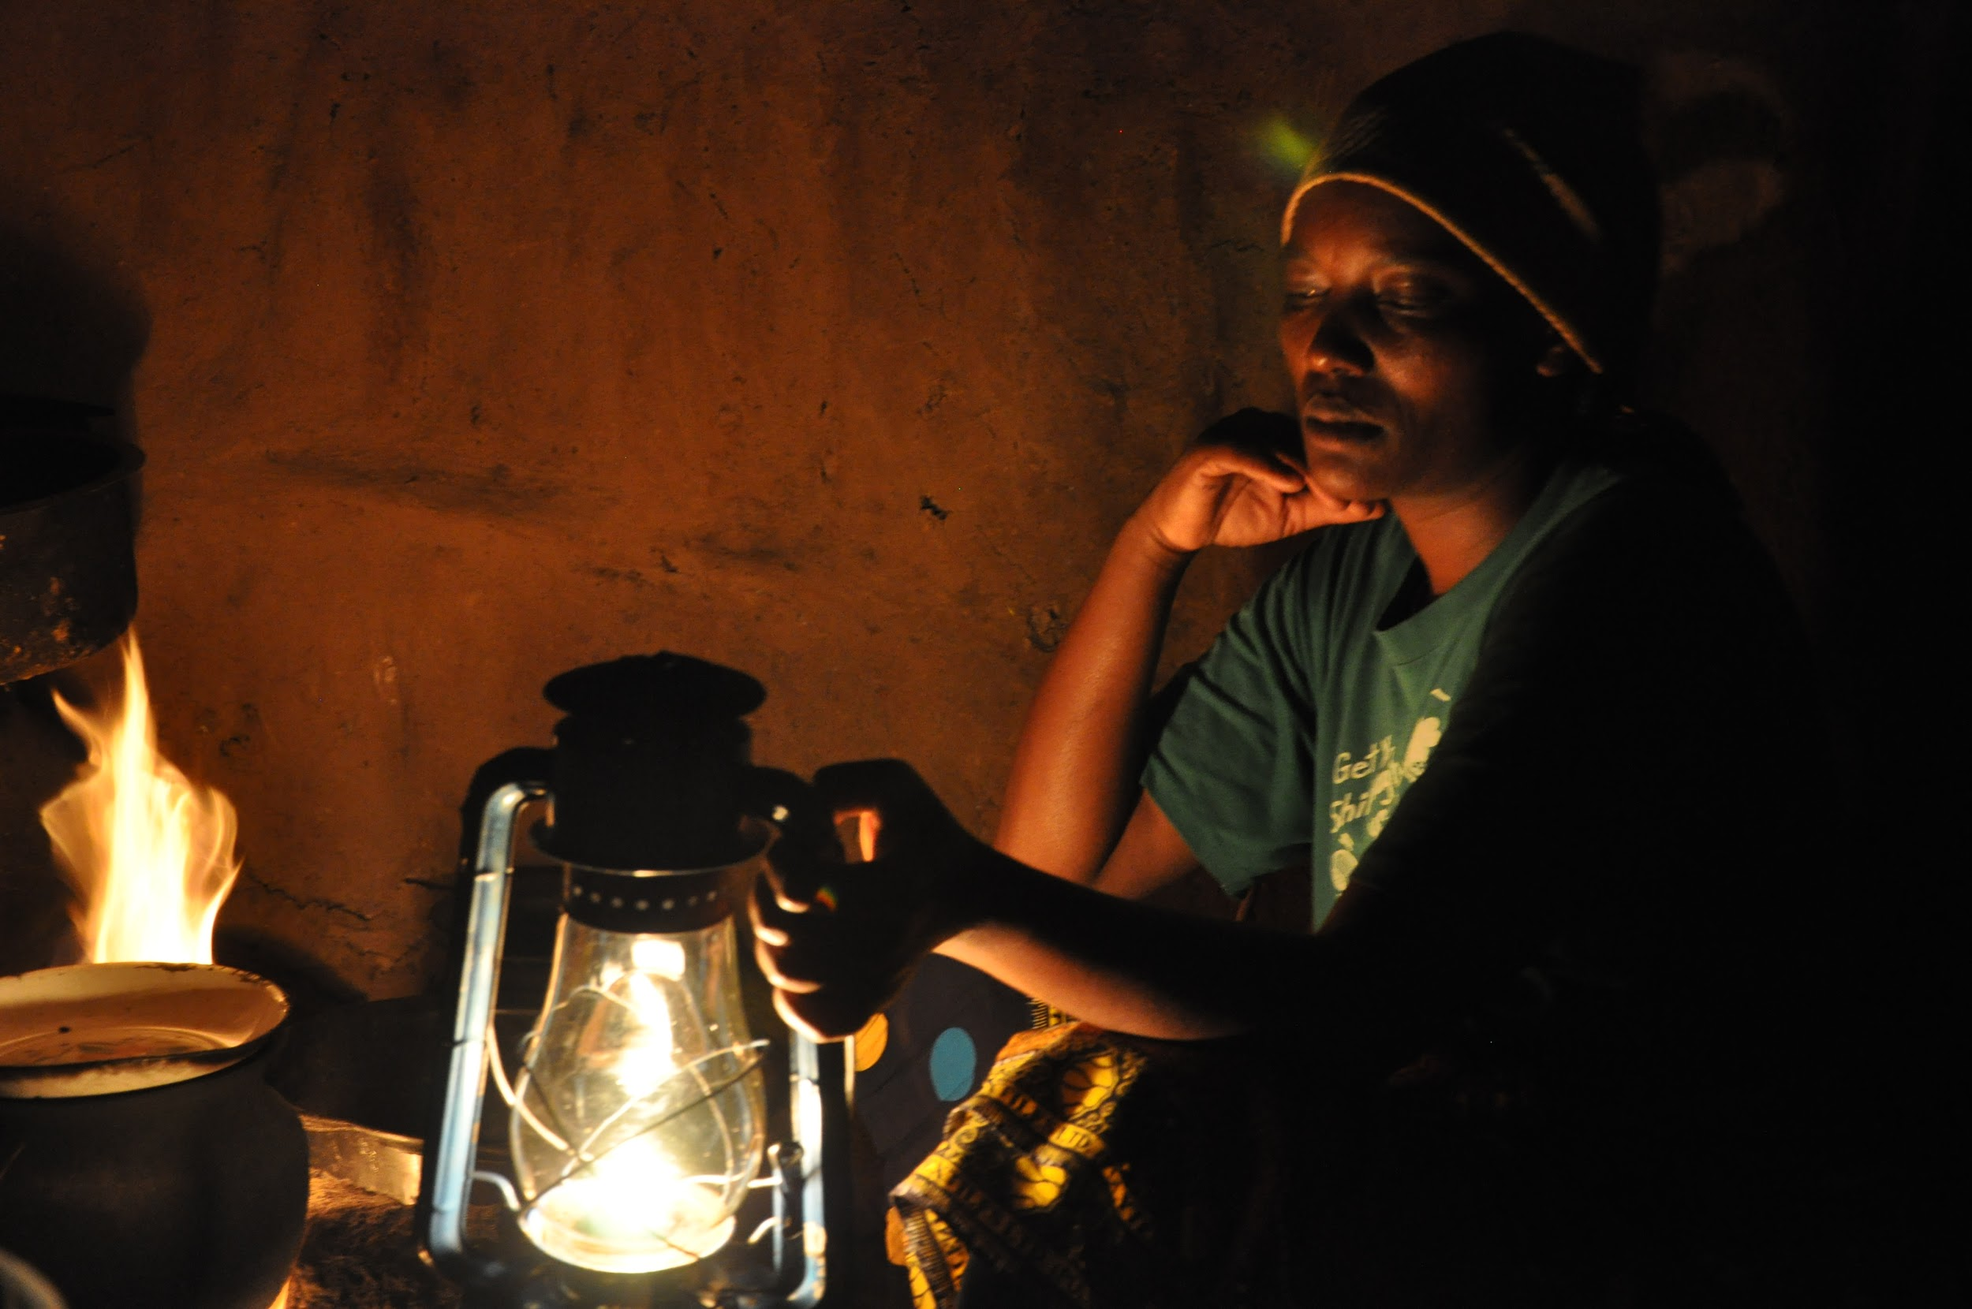
Kerosene
Whilst watching this clip, think about the following:
Why do people use kerosene for lighting?
What are some disadvantages of using kerosene?
What would be different if the student shown didn’t have to use kerosene?

Slide 18
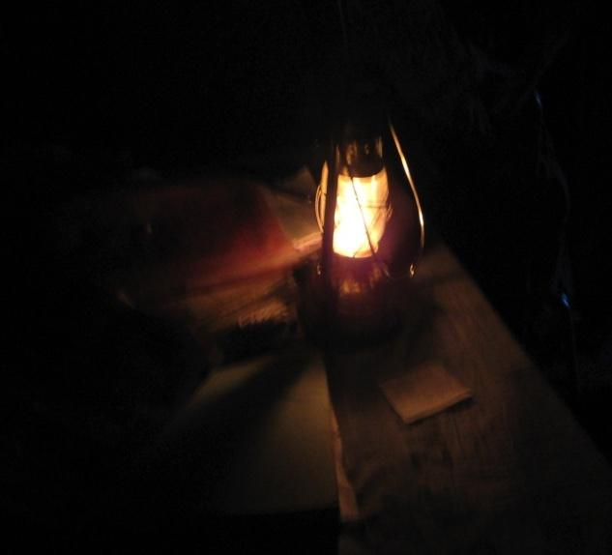
How Much Does
Kerosene Lighting Cost?
Use of 4 hours/day
will consume about 3 liters of kerosene
(~$3) per month
* Wikipedia
Notes:
The alternative to no solar light is either Kerosene or a diesel generator:
Wikipedia: A kerosene lamp producing 37 lumens for 4 hours per day will consume about 3 litres of kerosene per month.^{[7]}
A light from a We Share Solar Suitcase produces 300 to 400 lumens per light.
Typical We Share Solar Suitcase provides 5 to 8 lights that can be run for 3 to 5 hours per night [plus many hours during the day; limit is battery]
Note: lighting is measured in lumens. One hour of light at a rate of 1 lumen equals 1 lumen-hour.
SYSTEM TYPES

Slide 19
Basic Electricity and Using a multimeter - Teacher Notes
10.30 - Warm Up and share out
10.40 - Basic electricity notes voltage and current
10.50 - Students draw their own models using water analogy
10.55 Peer feedback
11.00 - Basic electricity notes power and energy including demonstration (1A object and 10A object dropped from different voltages)
11.10 - Students draw their own models
11.15 - Peer feedback

Slide 20
Basic Electricity and Using a multimeter - Teacher Notes
11.20 - Practice Problems and answers
11.30 - How to use a multimeter - watch voltage and current sections of video then practice with simple circuits
12.00 - Lunch

Slide 21
Basic Electricity
Tuesday June 28th 2016
Warm Up:
In your notebook write down any words you can think of that are associated with electricity

Slide 22
Basic Electricity
Tuesday June 28th 2016
Learning Targets:
To be able to describe the following electrical terms: voltage, amps, watts, and watt-hours
To be able to explain the relationship between volts, amps and watts, and perform simple electrical calculations with these values
To be able to calculate energy needs of a load given the power rating and hours of consumption

Slide 23
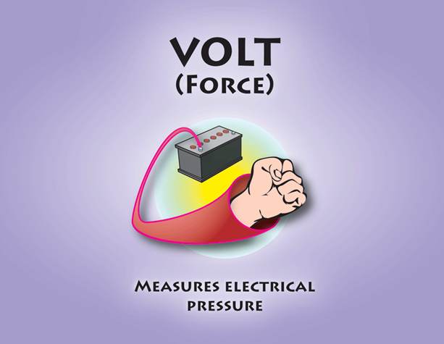
VOLTAGE, VOLTS (V)
Courtesy Clay Atcheson
ELECTRICITY BASICS FOR SOLAR | ‹#›

Slide 24
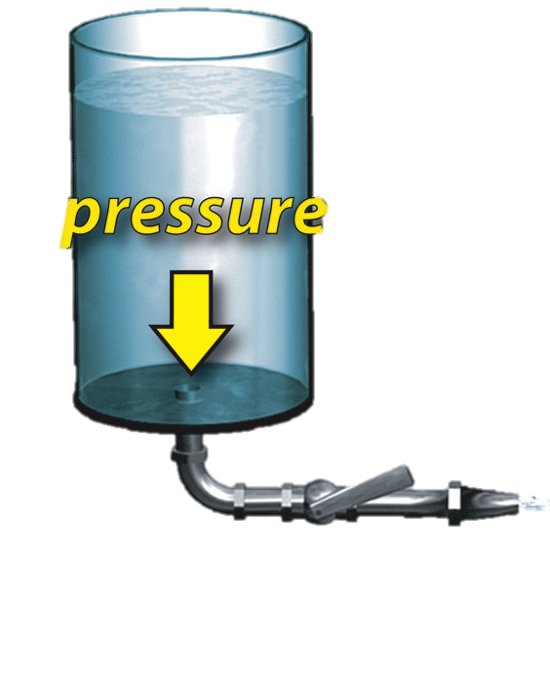
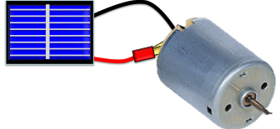

VOLTAGE
Difference causes force
Electromotive force
Water Analogy: Pressure
ELECTRICITY BASICS FOR SOLAR | ‹#›

Slide 25
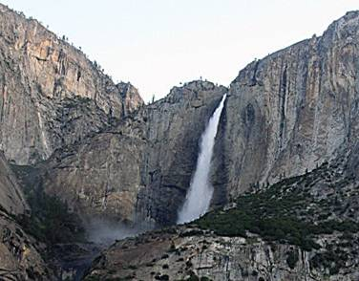
HIGH VOLTAGE OR LOW VOLTAGE?
Courtesy Clay Atcheson
ELECTRICITY BASICS FOR SOLAR | ‹#›

Slide 26
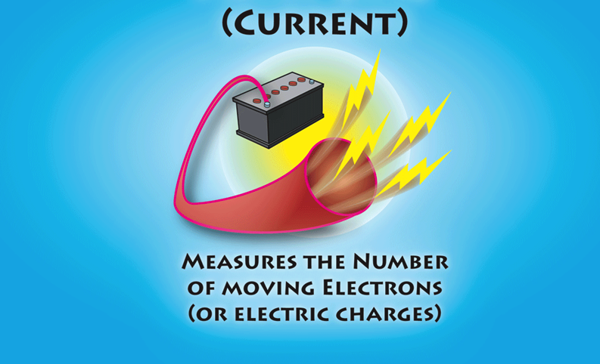
AMPERAGE, AMPS (A)
Courtesy Clay Atcheson
ELECTRICITY BASICS FOR SOLAR | ‹#›

Slide 27
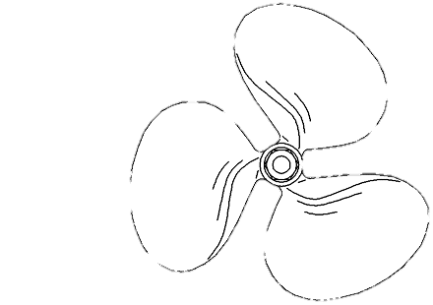

AMPS
Flow of electrical charges
Only measurable when circuit is closed (on)
Water analogy: gallons per minute, volume
Gallons / minute
ELECTRICITY BASICS FOR SOLAR | ‹#›

Slide 28
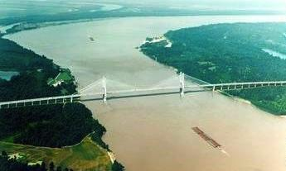
RIVER IN TERMS OF VOLTS AND AMPS
ELECTRICITY BASICS FOR SOLAR | ‹#›

Slide 29
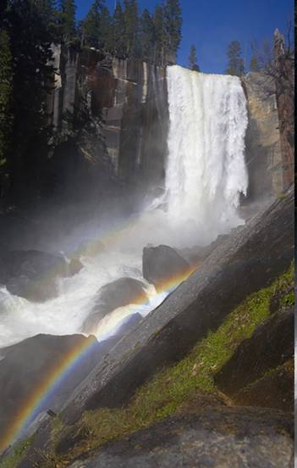
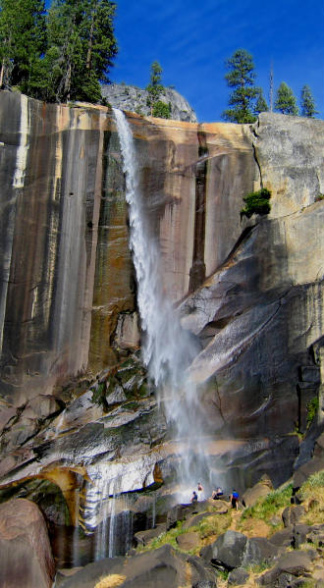
SAME WATERFALL - DIFFERENT SEASONS
ELECTRICITY BASICS FOR SOLAR | ‹#›

Slide 30
Volts and Amps
In your notebook draw and label your own model using the water analogy to explain what voltage and current are.

Slide 31
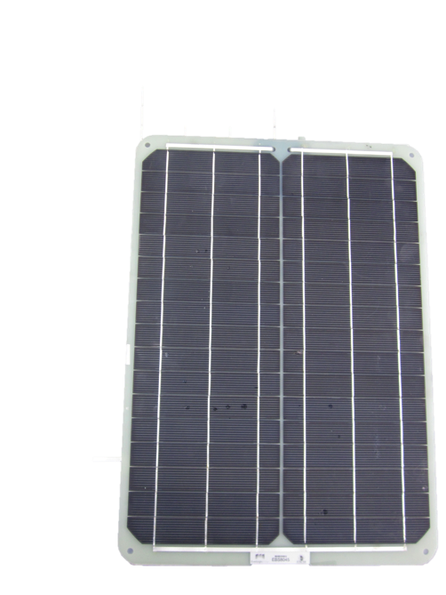
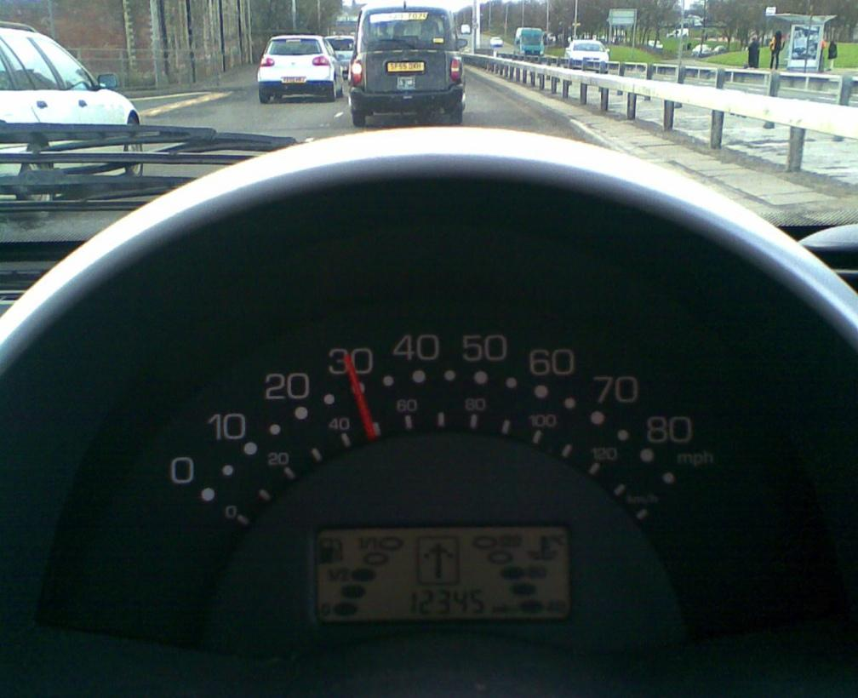
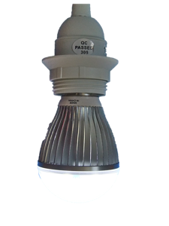

WATTS: RATE OF ENERGY USE OR PRODUCTION
Instantaneous rate of energy generation or use
Driving analogy- miles/hour
ELECTRICITY BASICS FOR SOLAR | ‹#›

Slide 32
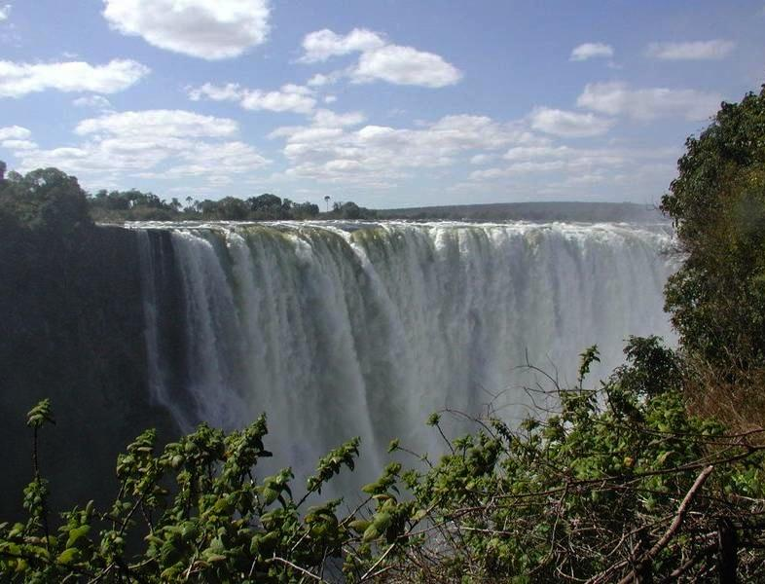
LOTS OF POWER!
ELECTRICITY BASICS FOR SOLAR | ‹#›

Slide 33
WATTS, VOLTS AND AMPS
Voltage x Current = Power
Volts x Amps = Watts
12 volts x 5 amps = 60 watts
P = IV
ELECTRICITY BASICS FOR SOLAR | ‹#›

Slide 34


DEMONSTRATION OF POWER
10 A
1 A
ELECTRICITY BASICS FOR SOLAR | ‹#›

Slide 35
ENERGY, WATT-HOURS (Wh)
Watts x hours = Watt-hours (Wh)
Energy = Power x Time
ELECTRICITY BASICS FOR SOLAR | ‹#›

Slide 36
Power
In your notebook draw and label your own model to explain how current and voltage effect power.

Slide 37

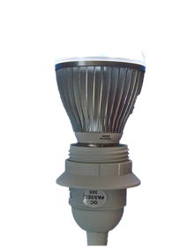

WATTS, VOLTS AND AMPS
Volts x Amps = Watts
Typical light bulb
120 volts x 0.5 amps = _______
12 volts x 5.0 amps = _______
WSS LED
12 volts x 0.5 amps = _______
ELECTRICITY BASICS FOR SOLAR | ‹#›

Slide 38
WATTS, VOLTS AND AMPS
Volts x Amps = Watts
Typical light bulb = 60 W
120 volts x 0.5 amps = 60 watts
12 volts x 5.0 amps = 60 watts
WSS LED = 6 W
12 volts x 0.5 amps = 6 watts
ELECTRICITY BASICS FOR SOLAR | ‹#›

Slide 39
PRACTICE USING POWER FORMULAS
Solar Cell
0.5 volts x 0.4 amps = _______ watts
Solar Module
12 volts x 1.7 amps = _________watts
ELECTRICITY BASICS FOR SOLAR | ‹#›

Slide 40
PRACTICE USING POWER FORMULAS
Solar Cell
0.5 volts x 0.4 amps = 0.2 watts
Solar Module
12 volts x 1.7 amps = 20.4 watts
ELECTRICITY BASICS FOR SOLAR | ‹#›

Slide 41
ENERGY, WATT-HOURS (Wh)
Watts x hours = Watt-hours (Wh)
Typical light bulb = 60 W
60 watts x 5 hours = __________
WSS LED = 6 W
6 watts x 5 hours = __________
ELECTRICITY BASICS FOR SOLAR | ‹#›

Slide 42
ENERGY, WATT-HOURS (Wh)
Watts x hours = Watt-hours (Wh)
Typical light bulb = 60 W
60 watts x 5 hours = 300 watt-hours
WSS LED = 6 W
6 watts x 5 hours = 30 watt-hours
ELECTRICITY BASICS FOR SOLAR | ‹#›

Slide 43
Solar Resource Page
Value Measured in Symbol
Voltage Volts (V) V
Current Amps (A) I
Power Watts (W) P
Energy Watt-hours (Wh) E
Equations
Power = Current x Voltage P = IV Watts = Volts x Amps
Energy = Power x Time E = Pt Watt-hours = Watts x hours

Slide 44
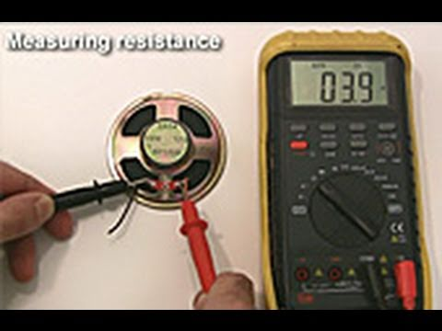
How to use a multimeter
Add any useful notes to your “Using a digital multimeter” sheet whilst watching this video

Slide 45
The PV Effect
Tuesday June 28th 2016
Learning Target:
To be able to describe and explain the relationship between light intensity and voltage / current.
Warm Up
How do you think a solar cell produces electricity? Draw a diagram in your notebook illustrating your idea

Slide 46
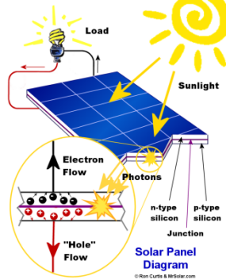
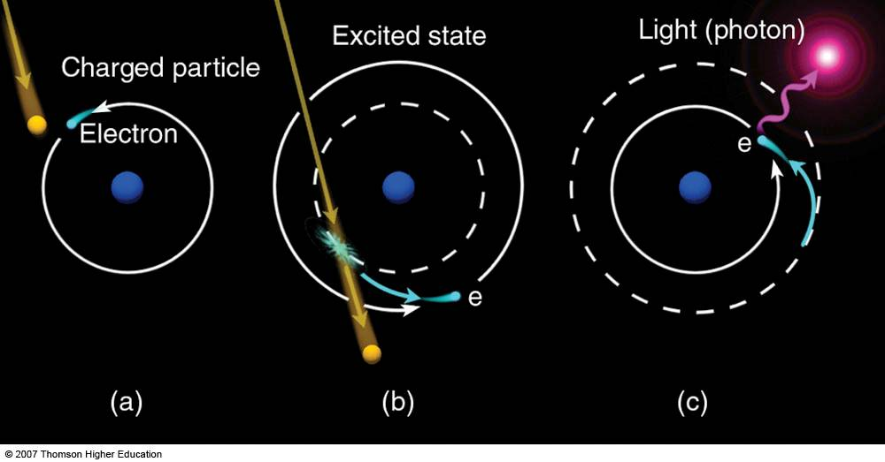
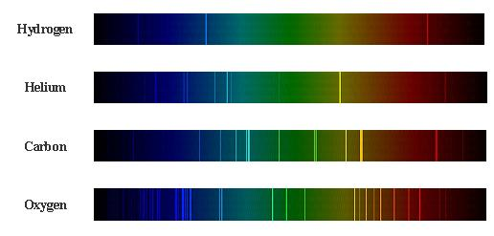
The Photovoltaic Effect

Slide 47
Lab 2: The PV Effect

Slide 48
Day 3
8.15 - 8.30: Arrival and Breakfast
8.30 - 9.15: Community building
9.15 - 10.15: Solar engineering prep - Equations for Electricity
10.15 - 10.30: Break
10.30 - 12.00: Basic electricity review, series and parallel circuits
12.00 - 12.30: Lunch
12.30 - 2.00: Lab 3: Series wiring and
Lab 4: Parallel wiring
2.00- 2.15: Group Reflection
2.15 - 2.30: Break
2.30 - 3.15: College and Career
3.15 - 3.30: Closing reflections
Wednesday June 29
Community Building
Equations used in Electricity
Series and Parallel circuits
Wiring Series and Parallel circuits
College and Career

Slide 49
Power, Electricity and Variations
Wednesday June 29th 2016
Learning Target:
To be able to use equations involving power, current, voltage and energy
Warm Up
If the amount of current increases, what happens to the power?
If the amount of voltage increases, what happens to the power?
Do you know what these types of relationships are called?

Slide 50
Power = Current x Voltage
Watts = Amps x Volts
P = IV
Power (Watts)
Power (Watts)
Current (Amps)
Voltage (Volts)

Slide 51
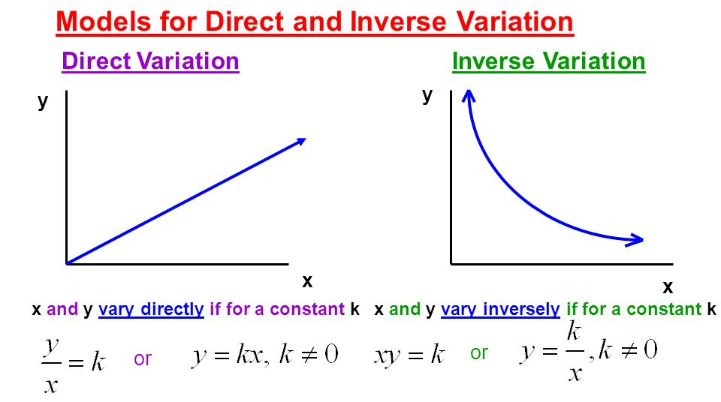

Slide 52
Types of circuits - Teacher Notes
10.30 - Warm Up
10.40 - Students arrange circuits, make notes of differences, discuss
10.50 Share out
10.55 We Care Solar video and share
11.05 Series wiring notes
11.20 Instructions for lab - everyone takes notes; take turns; scan through instructions first; all notes in notebook
11.25 Outside for lab
11.55 Debrief

Slide 53
Types of Circuits
Wednesday June 29th 2016
Learning Target:
To be able to explain the differences between series and parallel circuits
Warm Up
If you had four solar cells and one motor (and a bunch of wires), how many different ways could you arrange them in a circuit? Draw your circuits in your notebook.

Slide 54
As a group, use the solar cells, motor and wire to make the circuits you have thought of.
Are there any others?
In your notebook record:
A description of the ways you can change the circuits
A reflection on how you think these differences might affect the speed of the motor

Slide 55
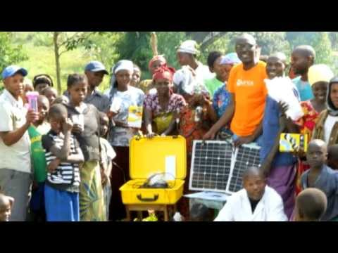
We Care Solar Video
While you are watching this, note down as many reasons you can think of for why understanding wiring is important when building the solar suitcase.

Slide 56
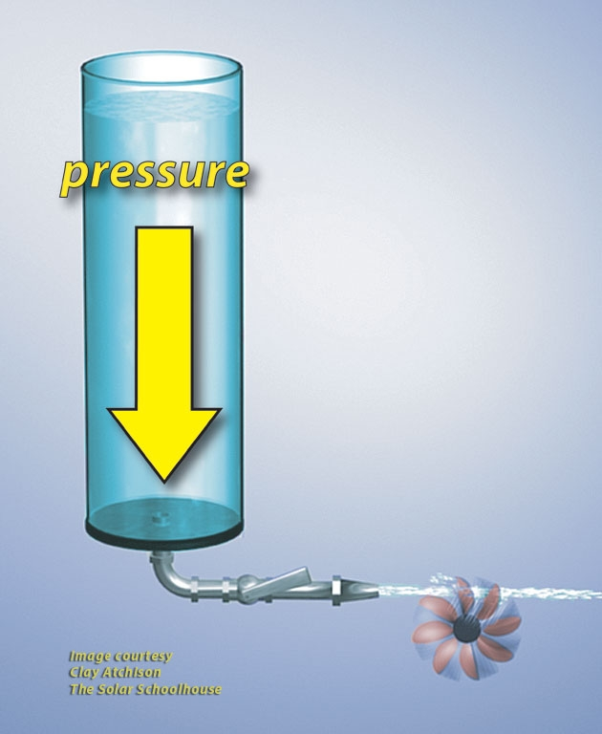
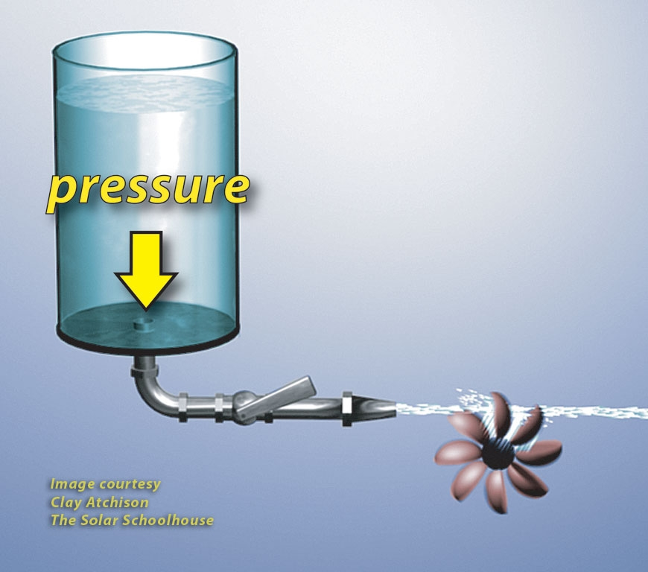
double the cylinder’s height, double the pressure
© 2013 Hal Aronson & Laura Walters

Slide 57
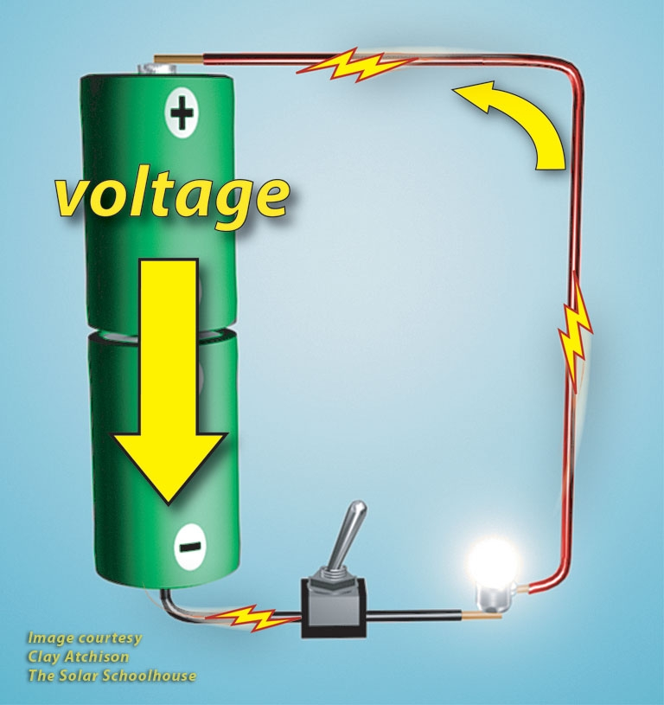
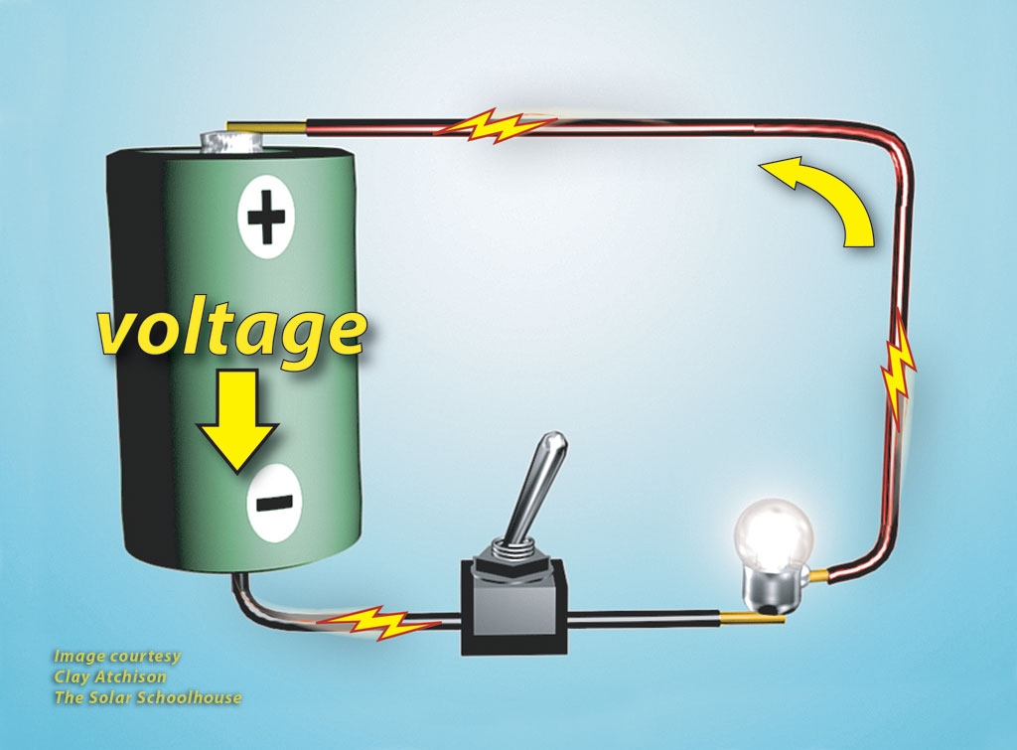
double the # of batteries in series, double the voltage
© 2013 Hal Aronson & Laura Walters

Slide 58
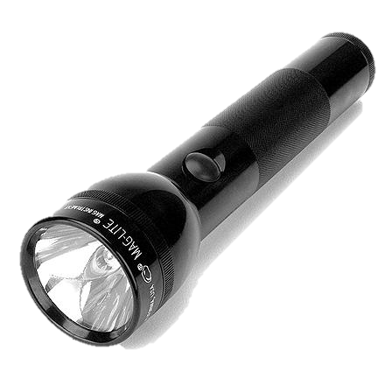
Series Wiring
Positive to negative
© 2013 Hal Aronson & Laura Walters

Slide 59
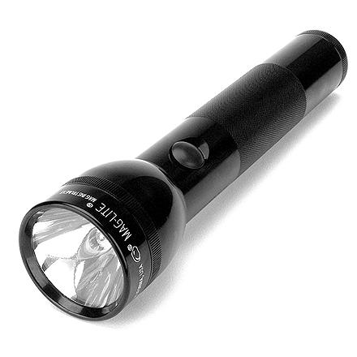
Series Wiring
volts add and amps stay constant
1.5 volts
+
1.5 volts
= 3 volts
© 2013 Hal Aronson & Laura Walters

Slide 60












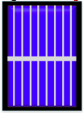
Solar Cells in Series
Current
0.4 amps
Voltage
0.5 volt
0.5 volt
0.5 volt
0.5 volt
2 volts
+
--
+
--
+
--
+
--
+
0.5 volts
0.4 amps
0.5 volts
0.4 amps
0.5 volts
0.4 amps
0.5 volts
0.4 amps
© 2013 Hal Aronson & Laura Walters

Slide 61



















Testing Voltage
2 V
V
600
OFF
V
600
200
200
20
2
2m
20m
200m
200K
DC
10A
Ω
20K
2K
200
10 ADC
COM
V Ω
© 2013 Hal Aronson & Laura Walters
© 2013 Hal Aronson

Slide 62
Lab 3: Exploring Series Wiring with Solar Electricity

Slide 63
Types of circuits - Teacher Notes
12.30 - Warm Up and share out
12.40 - Human circuits; series then parallel
12.50 - Record circuits in notebooks
1.00 - Parallel notes and practice problems (8 circuits around room on poster paper)
1.15 - Parallel lab
1.35 - Challenge
1.55 - Back inside; concept debrief
2.00 - Toolbox inventory and group reflection

Slide 64
Types of Circuits
Wednesday June 29th 2016
Learning Target:
To be able to explain the differences between series and parallel circuits
Warm Up
Use the waterfall model from yesterday to explain what happens to voltage and current when solar panels are wired in series.

Slide 65
Human circuits
2 people are solar cells
Everyone else is an electrical charge
The solar cell gives each charge a “push” which is enough to get them around the circuit. This represents voltage
The number of electrical charges passing a point at any time represents current

Slide 66
Human circuits
In your notebook sketch the two different circuits we made.
Which one was a series circuit?
What happened to the amount of voltage and current in each circuit?

Slide 67


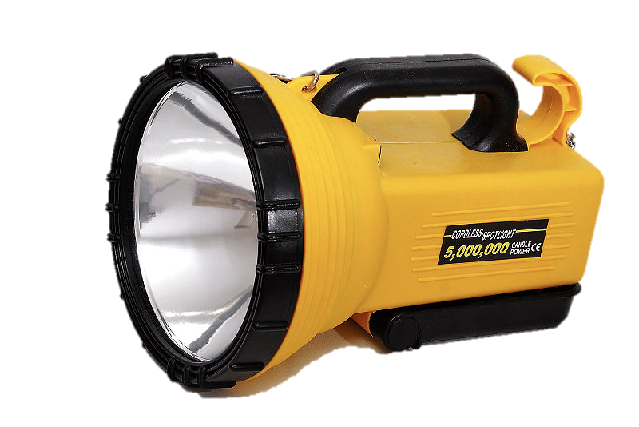

Parallel Wiring
double the batteries in parallel, double the capacity
+
+
--
--
+
+
--
--
© 2013 Hal Aronson & Laura Walters

Slide 68



















Parallel Connection- Current Adds
0.8 A
V
600
OFF
V
600
200
200
20
2m
2
20m
200m
200K
Ω
20K
DC 10A
2K
200
10 ADC
COM
V Ω
0.5 volts
0.4 amps
0.5 volts
0.4 amps
© 2013 Hal Aronson & Laura Walters

Slide 69

















Series and Parallel Wiring
© 2013 Hal Aronson & Laura Walters

Slide 70
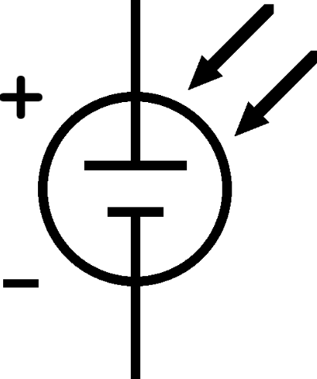
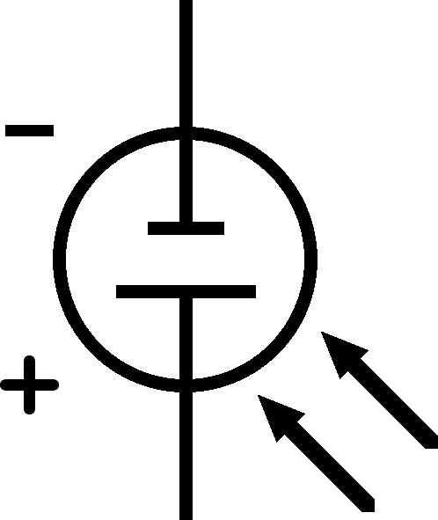
Series and Parallel Wiring
© 2013 Hal Aronson & Laura Walters

Slide 71
SAV PAA
Series adds volts Parallel adds amps
(amps stays same) (volts stays same)
© 2013 Hal Aronson & Laura Walters

Slide 72
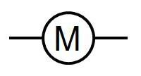
Circuit Symbols
Motor
Solar Cell

Slide 73





















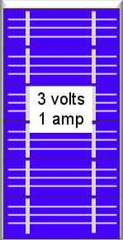
Series and Parallel Connections
? V
? A
© 2013 Hal Aronson & Laura Walters

Slide 74
Series and Parallel Connections
12 V
1 A
© 2013 Hal Aronson & Laura Walters

Slide 75

































Series and Parallel Connections
? V
? A
© 2013 Hal Aronson & Laura Walters

Slide 76
Series and Parallel Connections
12 V
2 A
© 2013 Hal Aronson & Laura Walters

Slide 77
Write your own solar circuit problem
You can use 10 solar cells or less
Each solar cell will produce 0.5V and 0.4A

Slide 78
Lab 4: Exploring Parallel Wiring with Solar Electricity

Slide 79
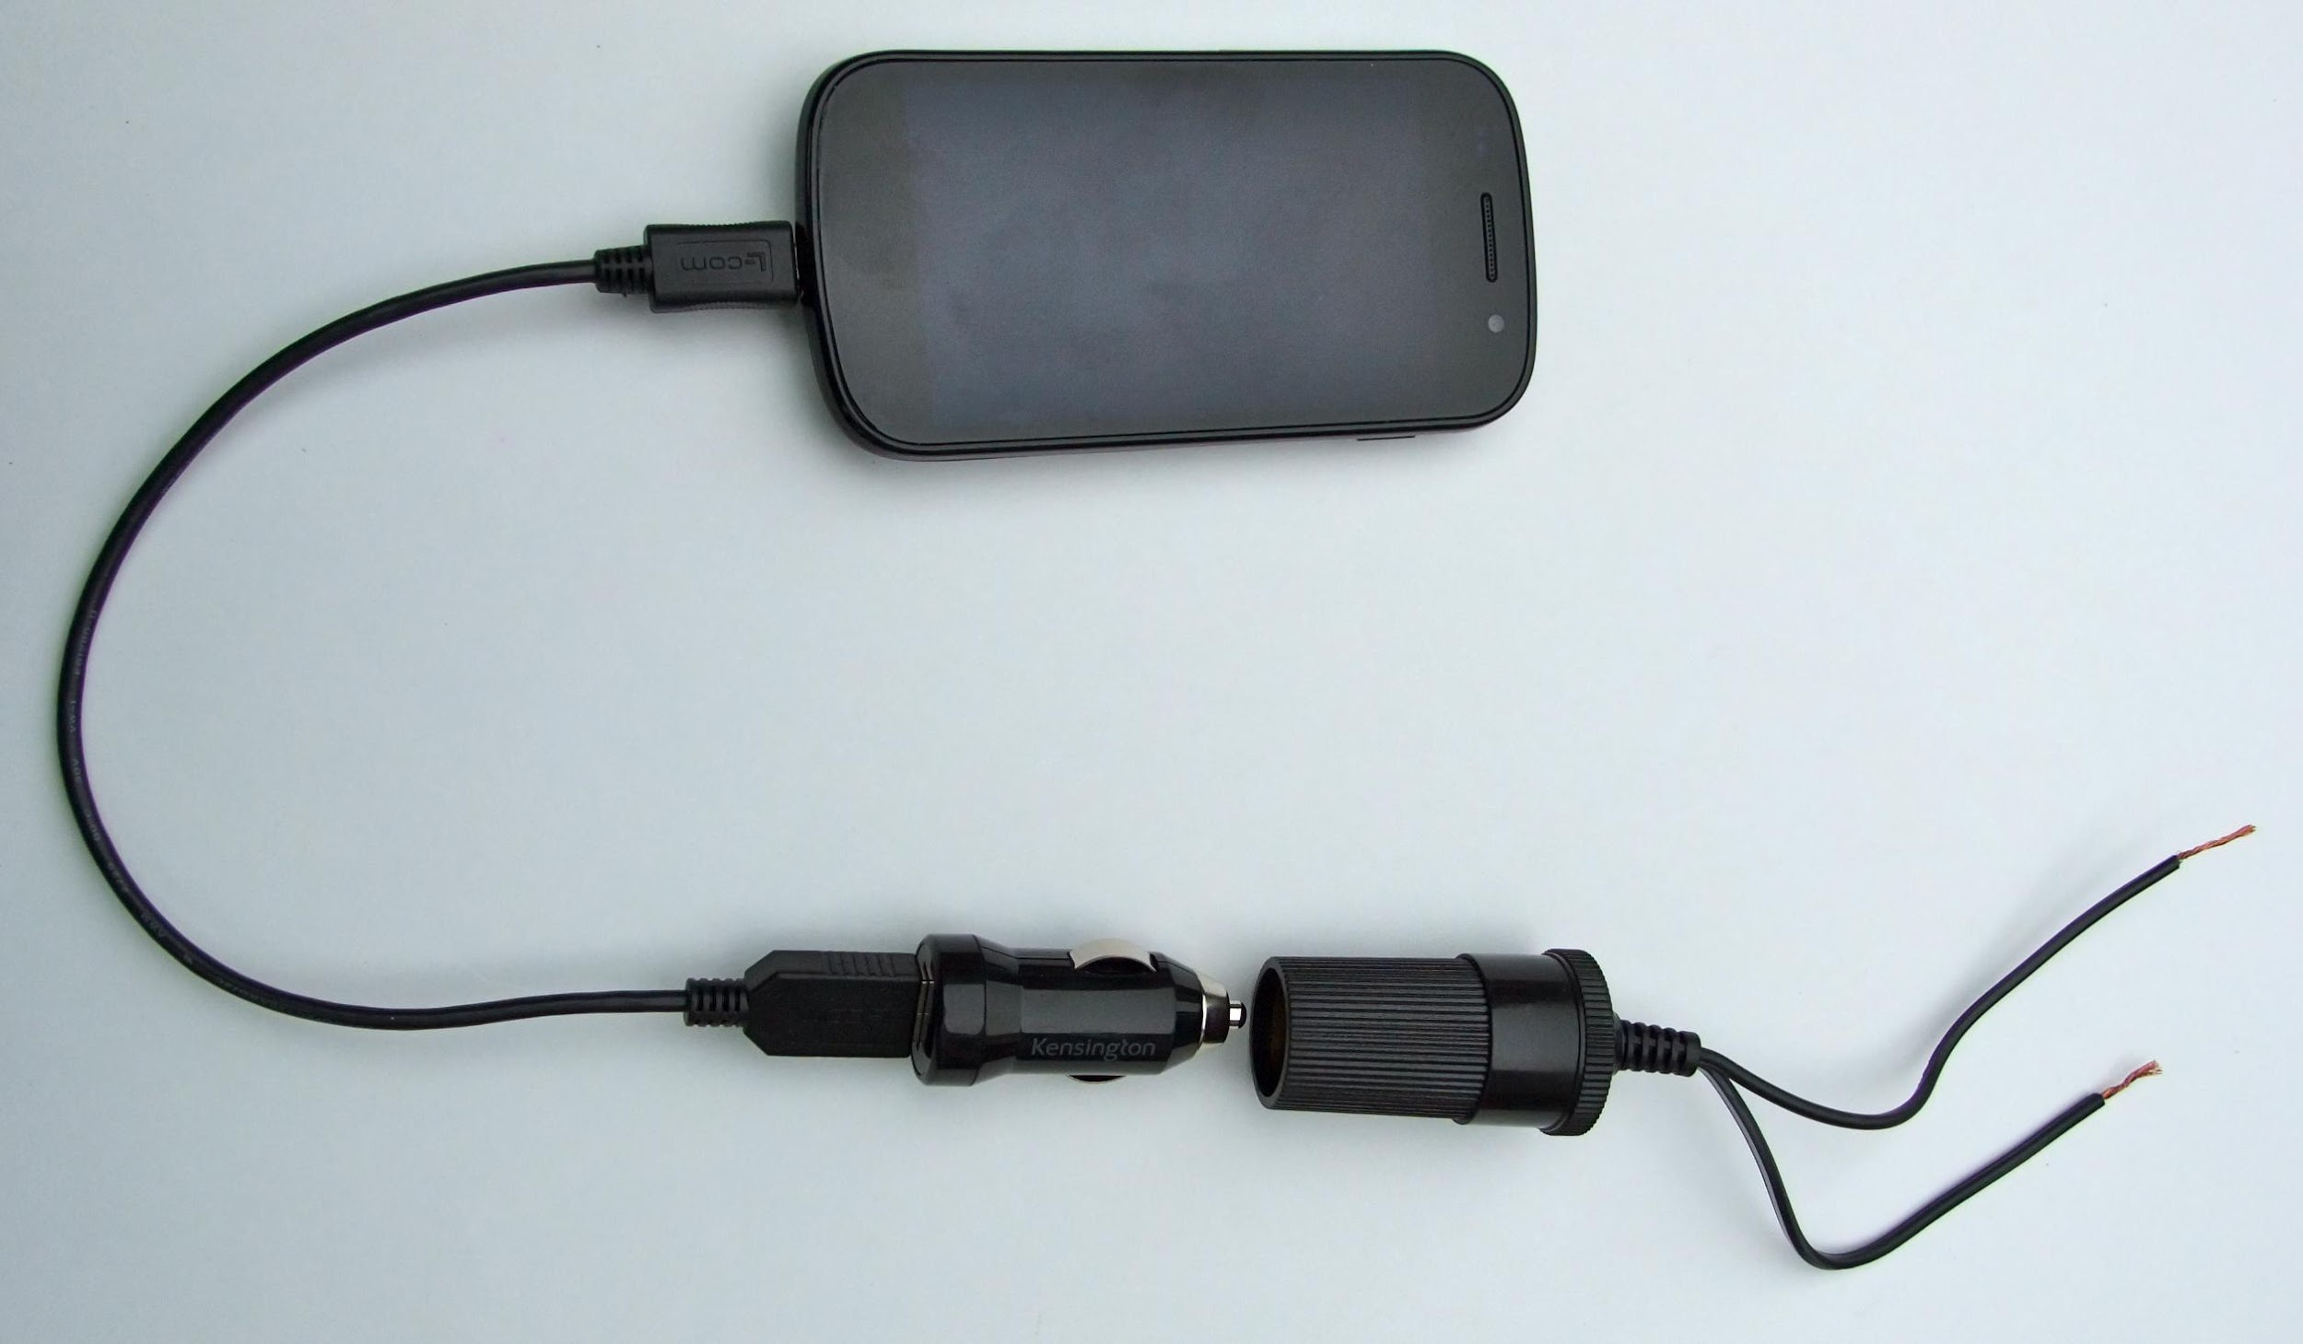
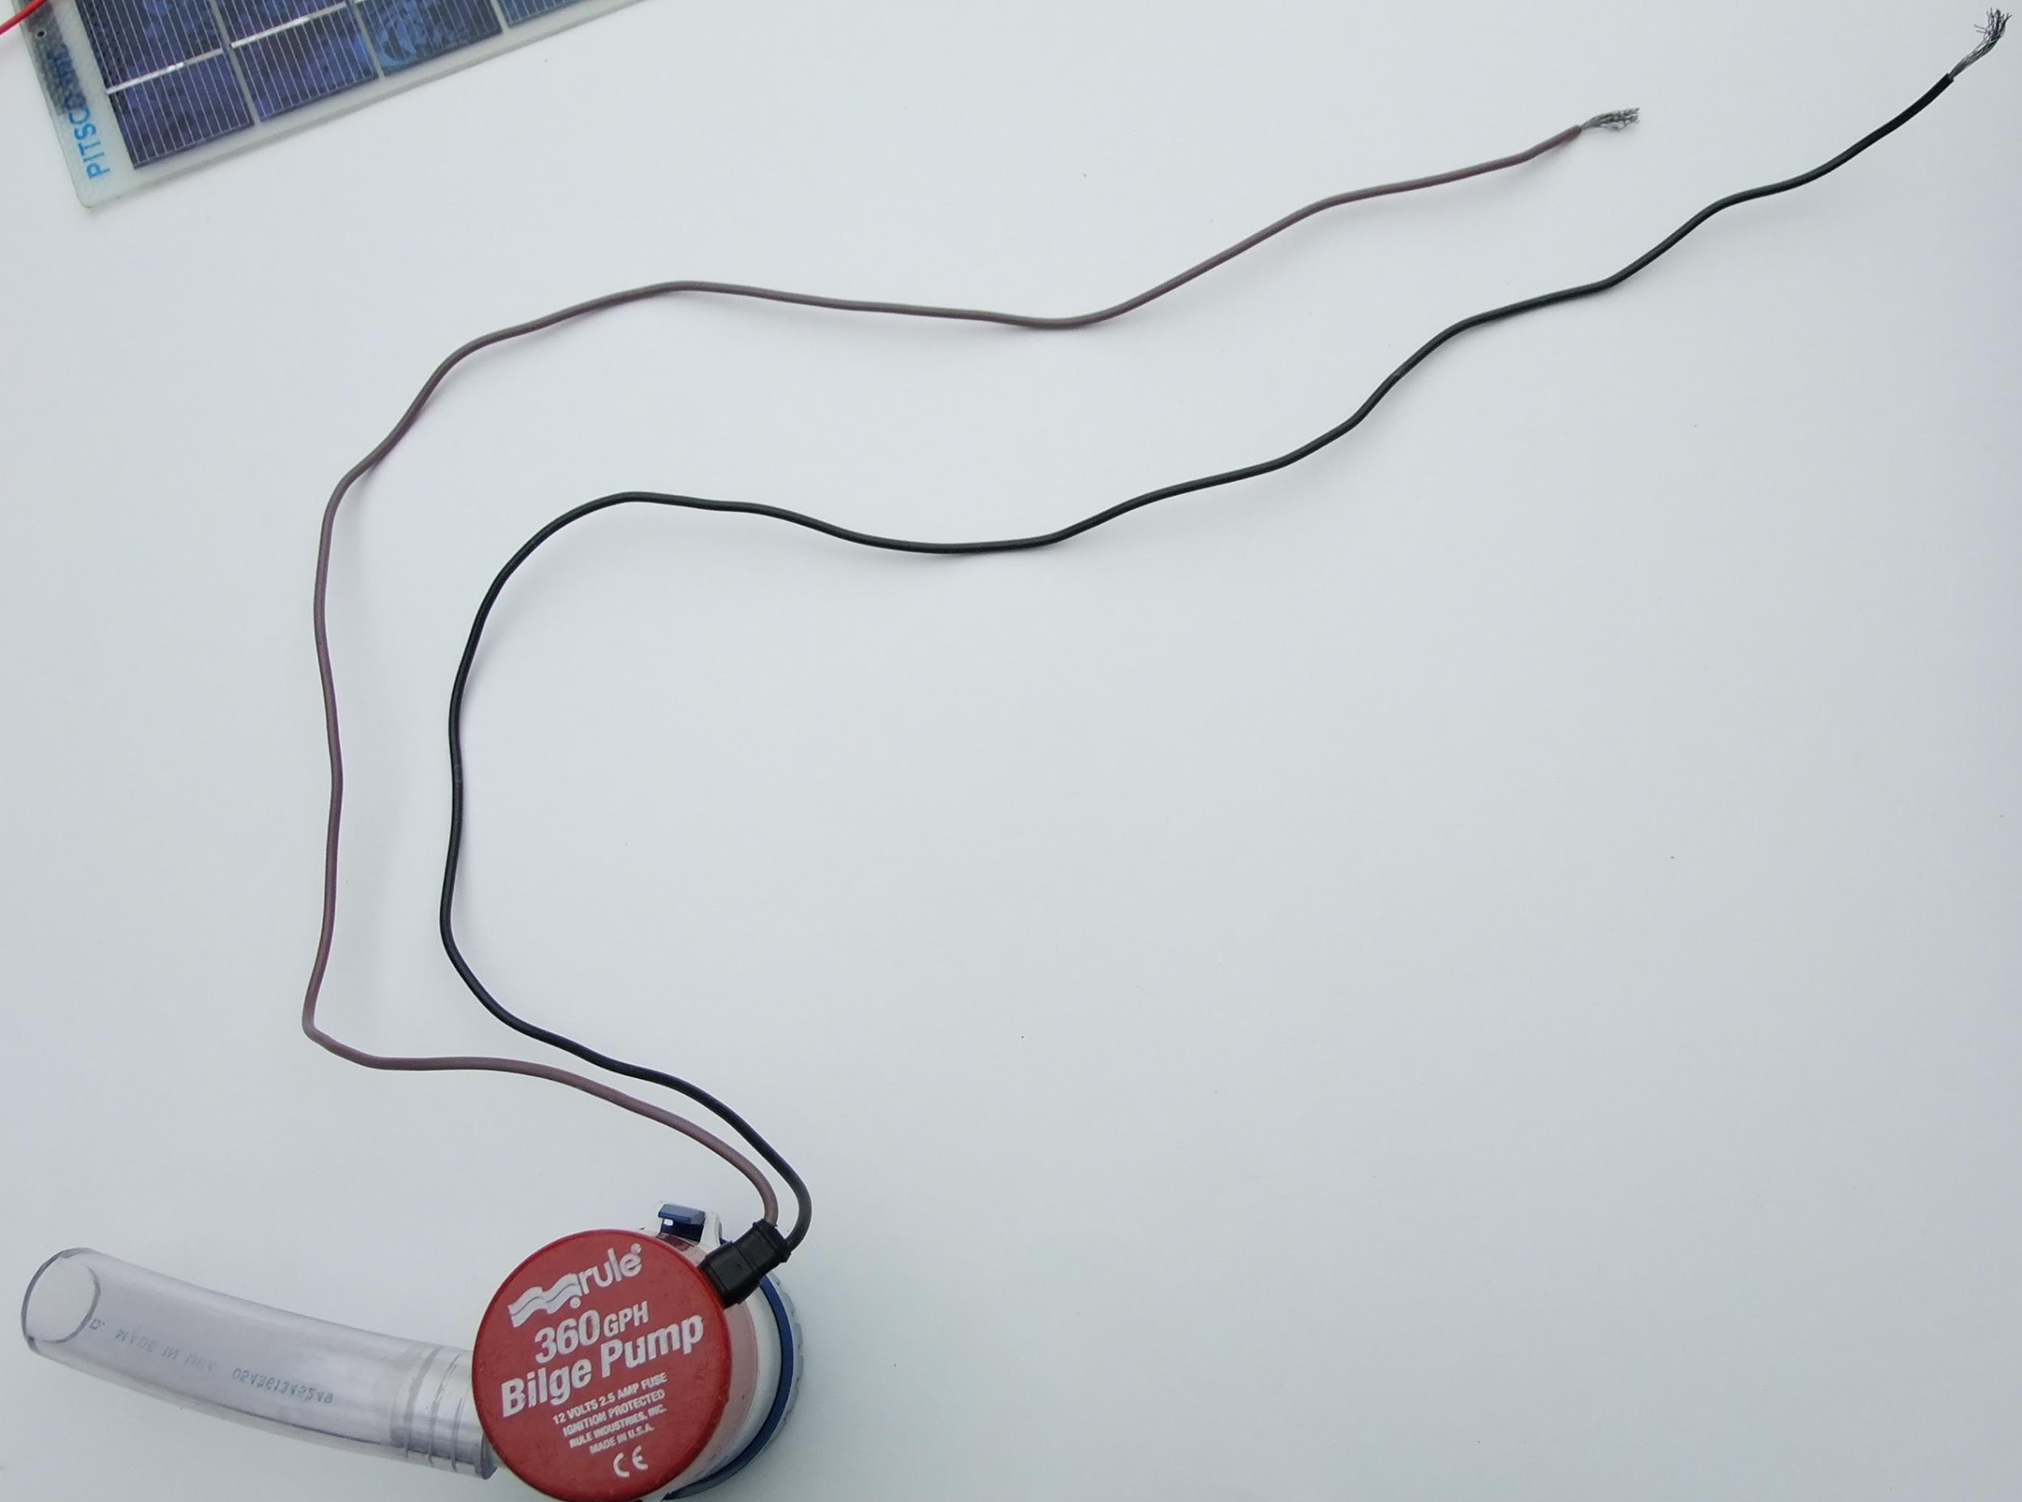
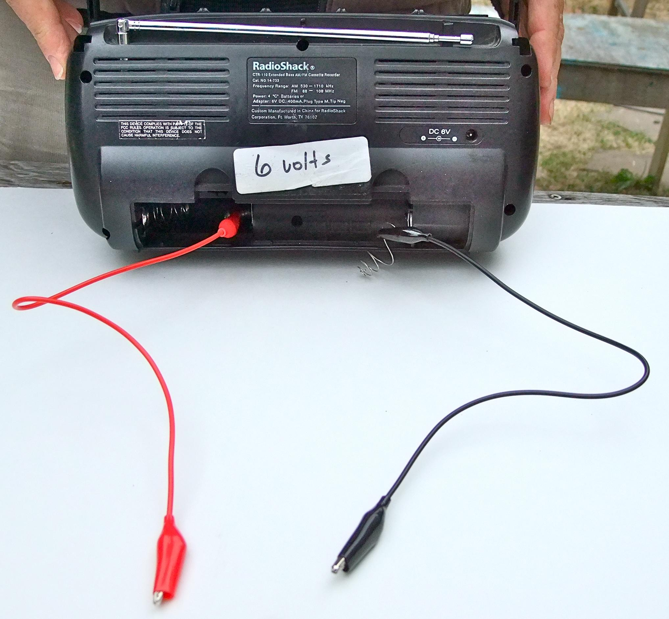
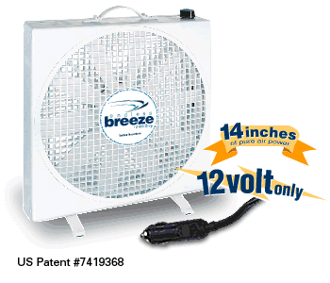
Challenge- Series & Parallel Wiring
© 2013 Hal Aronson & Laura Walters

Slide 80
Day 4
8.15 - 8.30: Arrival and Breakfast
8.30 - 9.15: Community building
9.15 - 10.15: Solar engineering prep - Calculations with Series and Parallel circuits
10.15 - 10.30: Break
10.30 - 12.00: Electrical continuity
12.00 - 12.30: Lunch
12.30 - 1.15: Lab 5: Water Pump
1.15- 2.15: Paying for college
2.15 - 2.30: Break
2.30 - 3.15: College System and Cost Jeopardy
3.15 - 3.30: Closing reflections
Thursday June 30
Community Building
Calculations with series and parallel circuits
Electrical continuity
Powering a water pump
Paying for college
College Systems and Cost Jeopardy

Slide 81
Calculations with Series and Parallel Circuits
Thursday June 30th 2016
Learning Target:
To be able to calculate values of voltage, current and resistance in series and parallel circuits
Warm Up
Yesterday we put solar cells in series and parallel circuits. Draw a series circuit and a parallel circuit, each containing two solar cells and one motor.

Slide 83
Electrical Continuity - Teacher Notes
10.30 - Warm Up and share out
10.40 - Read out description of electrical continuity
10.45 - Pass out multimeters that beep and watch continuity section of video (2.50 - 3.40). Explain differences between multimeters, how to test without the beep
10.50 - Students test continuity of jumper cable using both meters
10.55 - Demo wire stripping and terminal blocks
11.05 - Students test continuity of all components and make table in their notes. Teachers set up short circuits with lamp cord, explain how fuses work, explain short circuits using socket
11.50 - Each group demos one component

Slide 84
Electrical Continuity
Thursday June 30th 2016
Learning Target:
To be able to test for electrical continuity
Warm Up
Look at the title for this morning’s session. In your own words define what you think “electrical continuity” means.

Slide 85
Electrical Continuity
In electrical applications, when an electrical circuit is capable of conducting current, it demonstrates electrical continuity.
It is also said to be “closed,” because the circuit is complete. In the case of a light switch, for example, the circuit is closed and capable of conducting electricity when the switch is flipped to “on”.
You can break the continuity by flipping the switch to “off”; opening the circuit making it incapable of conducting electricity.

Slide 86
How to use a multimeter
Add any useful notes to your “Using a digital multimeter” sheet whilst watching this video

Slide 87
Component | What is it for? | Sketch | How do you test for continuity?
Jumper cable
Wire
Terminal block (with wires in)
Switch
Circuit Breaker
Lamp cord
Socket
Fuse

Slide 88
Continuity Test
Wire - strip then test
Jumpers (can leave attached)
Switches
Circuit breakers
Terminal blocks - practice wiring, then test continuity
Lamp cords - test for continuity between + and - (create short circuit by cutting plug off, exposing wires then connecting + and - then test for continuity)
Sockets - test for continuity between + and - (teach about short circuits)
Fuses

Slide 89
Water Pump
Thursday June 30th 2016
Learning Target:
To understand how the angle and direction of a solar panel affects the amount of power produced
Warm Up
If you were installing a solar panel on the roof of a building, what would you do to ensure that the most amount of power was produced? Draw a sketch if that is helpful.

Slide 90
Lab 5: Water Pump

Slide 91
Day 5
8.15 - 8.30: Arrival and Breakfast
8.30 - 9.15: Community building
9.15 - 10.15: Solar engineering prep - Rates and volumes
10.15 - 10.30: Break
10.30 - 12.00: Written formative assessment # 1
12.00 - 12.30: Lunch
12.30 - 2.00: Water pump competition and presentation
2.00- 2.15: Group Reflection
2.15 - 2.30: Break
2.30 - 3.15: College and Career
3.15 - 3.30: Closing reflections
Friday July 1
Community Building
Equations used in Electricity
Series and Parallel circuits
Wiring Series and Parallel circuits
College and Career

Slide 92
Rates and Volumes
Friday July 1st 2016
Learning Target:
To be able to complete calculations that involve rate and volume
Warm Up
Think back to the water pump lab yesterday. If you wanted to work out the rate or speed of the water, what measurements would you take?

Slide 93
Week 1 Formative Assessment
Friday July 1st 2016
Learning Target:
To demonstrate the knowledge you have learned so far this week!
Warm Up
Look back at the Solar Competency Checklist. Can you find anything you gave yourself a 1 for that is now up to a 4 or 5?

Slide 94
Week 1 Formative Assessment
Friday July 1st 2016
Competency Checklist Review Using Clickers
Notebook inventory and review
Written formative assessment #1
Groups for next week

Slide 95
Written Formative Assessment #1
What are the benefits of solar?
What is the PV effect?
How can you change the amount of electricity produced by a solar cell? What are independent, dependent and control variables?
Can you use models to explain electrical terms?
What is the difference between series and parallel wiring?
Can you use P = IV and V = IR?
Graphing and writing equations of straight lines

Slide 96
On your index card write down three people who you work well with.
At least one must be in a different grade.

Slide 97
Water Pump Competition - Teacher Notes
12.30 - Warm Up and share out
12.40 - Series and parallel circuit review group problems; groups take turns looking and questions then go over them all as a class
1.00 - Pose challenge to students, think, pair, share
1.05 - Groups combine and discuss their ideas
1.10 - Go outside and set up system
1.20 - Competition time: students get water jugs
1.30 - Back inside - reflect what did you you do well as a team
1.40 - Draw circuit, plan group presentation
1.50 - Present
2.00 - Tool inventory and group reflection

Slide 98
Water Pump Competition
Friday July 1st 2016
Learning Target:
To design a solar system to produce the fastest rate of water pumping
Warm Up
If you are designing a system with solar panels to power something, what do you need to know about voltage and current?

Slide 99
Your Challenge:
Design a solar array that will produce a 12v 2A current to power a water pump
You can use up to nine 3v 1A solar panels and will race to fill a 1 gallon water jug

Slide 100
How did your group do? Write a reflection on one thing you did well, one thing you could have done better.

Slide 101
Water Pump Competition Presentation
Friday July 1st 2016
Your presentation must include:
The circuit you designed and the math that you used
(2 - 3 people)
How you organized your system outside (1 person)
One strength your group had (1 person)
One challenge your group had (1 person)
A reflection on how this activity might relate to the real world (1 person)
One thing that you did today that you would not have been able to do last Friday (1 person)

Slide 102
Day 6
8.15 - 8.30: Arrival and Breakfast
8.30 - 9.15: Community building
9.15 - 10.15: Solar engineering prep - Battery and Panel Sizing
10.15 - 10.30: Break
10.30 - 12.00: Assessment Feedback
Meet the solar suitcase
12.00 - 12.30: Lunch
12.30 - 1.15: Wiring Diagram
1.15 - 2.15: Majors and Minors
2.15 - 2.30: Break
2.30 - 3.15: Majors and Careers in STEM
3.15 - 3.30: Closing reflections
Tuesday July 5
Community Building
Battery and Panel Sizing
Assessment Feedback
Meet the Solar Suitcase
Wiring Diagram
Majors and Minors
Majors and Careers in STEM

Slide 103
Warm Up
How did you feel about the assessment on Friday? Reflect in your journal. What will you do differently to prepare for the next one?

Slide 104
Warm Up
The solar suitcase uses a solar panel, battery and can power a light. In your notebook sketch a circuit that you think might work to connect them

Slide 105
Day 7
8.15 - 8.30: Arrival and Breakfast
8.30 - 9.15: Skype with Brian Inganga
9.15 - 10.15: Solar engineering prep - System Design
10.15 - 10.30: Break
10.30 - 11.15 - Community Building
11.15 - 12.00: Load Analysis and System Design
12.00 - 12.30: Lunch
12.30 - 2.00: Solar Suitcase Assembly
2.00- 2.15: Group Reflection
2.15 - 2.30: Break
2.30 - 3.15: College and Career
3.15 - 3.30: Closing reflections
Wednesday July 6
Skype with Brian in Kenya
Community Building
System Design
Load Analysis
Suitcase Assembly
College and Career

Slide 106
Life in the Kibera Slum - Kenya
Wednesday July 6th 2016
Learning Target:
To write and ask questions about life in the Kibera Slum
Warm Up
If you could talk to someone in Kenya what questions would you want to ask them? Write these in your notebook.

Slide 107
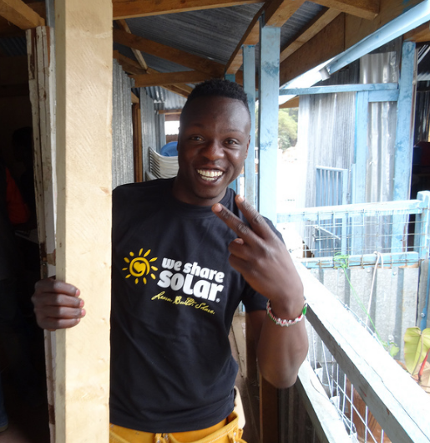
Brian Inganga
Born and raised in Kibera, the largest slum in Nairobi Kenya and the largest urban slum in ​Africa.
​At the age of 18yrs founded Change Mtaani (Change Your Neighborhood) youth community based organization which is dedicated to improving the environment and sanitation through sustainable practices in Kibera. They have installed a number of WSS suitcases and plan to install more.
He is a ​self ​taught ​Photojournalist based in Kenya who tries to tell stories that haven’t been told. He strives to tell stories about the individual, the community, the environment, and where all of these overlap.
He has covered US President Barack Obama visit to Kenya.
In the future Brian plans to go to school to study Environmental Climate Change and Journalism.

Slide 109
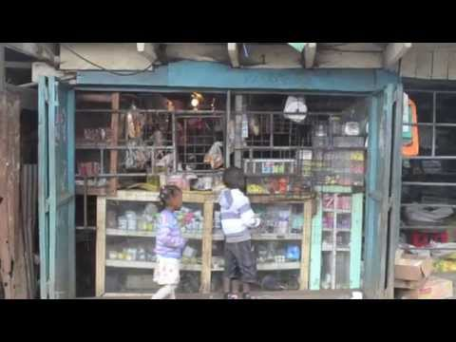
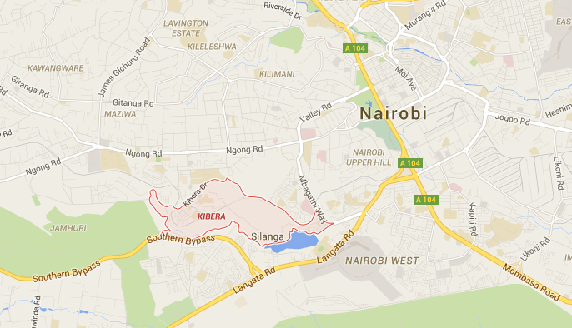

Slide 110
Question about daily life
Question about education
Question about electricity access

Slide 111
System Design
Wednesday July 6th 2016
Learning Target:
To be able to calculate battery size, solar panel size and charge controller size for a stand alone solar system
Warm Up
If you we designing a solar system from scratch:
Where would you want it to go?
What would you want it to be able to power?

Slide 112
Suitcase Building!
Wednesday July 6th 2016
Learning Target:
To be able to build and wire the solar suitcase
Warm Up
Clear up your surroundings - no bags on tables, put binders in one pile
Decide who will take each group role

Slide 114
Day 8
8.15 - 8.30: Arrival and Breakfast
8.30 - 9.15: Skype with Kenya students!
9.15 - 10.15: Solar engineering prep - Cost of building your designs
10.15 - 10.30: Break
10.30 - 11.00: Community Building
11.00 - 12.00: Shark Tank Preparation
12.00 - 12.30: Lunch
12.30 - 1.15: Suitcase Assembly
1.15- 2.15: What is a Career?
2.15 - 2.30: Break
2.30 - 3.15: How to secure a career
3.15 - 3.30: Closing reflections
Thursday July 7
Community Building
Cost of designs
Shark Tank Preparation
Suitcase Assembly
What is a career?
How to secure a career

Slide 115
Education In Enoosaen
Wednesday July 6th 2016
Learning Target:
To make contact with students in Enoosaen
Warm Up
If you could talk to STUDENTS who live in rural Kenya, what questions would you have for them?

Slide 116

Enoosaen is a Maasai village of about 10,000 people located in the Transmara District of southwestern Kenya, about 250 miles west of Nairobi.

Slide 117
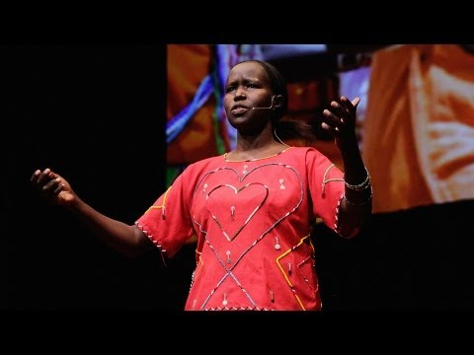

Slide 118
System Design
Thursday July 7th 2016
Learning Target:
To be able to design a stand alone solar system
Warm Up
Look back at your system design ideas from yesterday - what would you like to add to your idea? What would you power from your ideal solar system?

Slide 119
Suitcase Building!
Thursday July 7th 2016
Learning Target:
To be able to build and wire the solar suitcase
Warm Up
How well did you work as a team yesterday? Reflect in your notebook whether there is anything you will do in the same way or differently today.

Slide 120
Day 9
8.15 - 8.30: Arrival and Breakfast
8.30 - 9.15: Community building
9.15 - 10.15: Solar engineering prep - Review
10.15 - 10.30: Break
10.30 - 11.15: System Design
11.15 - 12.00 Written Assessment #2
12.00 - 12.30: Lunch
12.30 - 1.15: Shark Tank Pitch Preparation
1.15- 2.15: Shark Tank
2.15 - 2.30: Break
2.30 - 3.15: College and Career
3.15 - 3.30: Closing reflections
Friday July 8
Community Building
Review
Formative Assessment #2
Shark Tank
College and Career

Slide 121
System Design
Friday July 8th 2016
Learning Target:
To be able to design a stand alone solar system
Warm Up
Find your “Designing Stand Alone Solar Electric Systems” hand out. Where did you get as a group yesterday? Would you be able BY YOURSELF to find battery, solar panel and charge controller size?

Slide 122
System Design
Complete your design and make sure EVERYONE in the group knows how to follow the steps for battery, solar panel and charge controller sizing
Draw a single line diagram
Decide what will go on your display (you get two large pieces of paper)
Come up with a name for your company and / or your project idea
Start to think about the main points you need to communicate to the investors

Slide 123
Your Pitch
What is the need or problem you are addressing?
How does your system work?
How does it address the problem?
What is the cost?
What is your value proposition - why is your product worth the money?

Slide 124
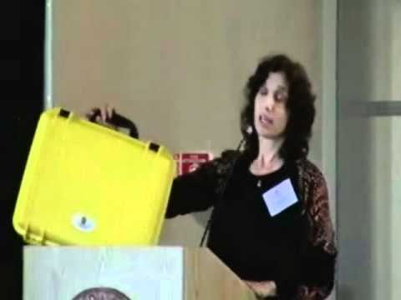
WE CARE Solar Elevator Pitch

Slide 125
Day 10
8.15 - 8.30: Arrival and Breakfast
8.30 - 9.15: Community building
9.15 - 10.15: Solar engineering prep - Reading Electricity Bills
10.15 - 10.30: Break
10.30 - 11.15: Formative Assessment #2 Feedback
11.15 - 12.00 Shark Tank Reflection and planning for final presentation
12.00 - 12.30: Lunch
12.30 - 2.00: Suitcase Quality Control and Energizing
2.00- 2.15: Group Reflection
2.15 - 2.30: Break
2.30 - 3.15: College and Career
3.15 - 3.30: Closing reflections
Monday July 11
Community Building
Reading Electricity Bills
Assessment Feedback
Planning for final presentation
Suitcase Quality Control and Energizing
College and Career

Slide 126
Understanding Electricity Bills
Monday July 11th 2016
Learning Target:
To be able to perform calculations using electricity bills
Warm Up
Write in your notebook: In your home when do you think you use the most electricity? Think about your electricity use:
Each day
Each week
Each month
Each year

Slide 127
As a group make a presentation skills action plan.
For each person identify:
One strength when presenting
Two areas to work on

Slide 128
Final Presentation Friday July 15th
1.30 - 2.30pm in the Cafeteria
You will present for 10 mins, take questions for 10 mins then repeat!
Guests may include:
Family members; O High Teachers and Administrators; OUSD Staff; UC and Cal State professors and students
You need to be able to:
Explain how the solar suitcase works
Describe where your suitcase is going and how it will be used
Explain what voltage, current, energy and power mean

Slide 129
Before Break:
Tool Inventory
Pack up solar suitcase
Return battery to the front
Wash hands before eating anything!

Slide 130
Formative Assessment #2
Monday July 11th 2016
Learning Target:
To reflect on the written assessment and presentation assessment from last week
Warm Up
How do you think you did on Friday? In your notebook, reflect on your performance with the written assessment and the Shark Tank presentation.

Slide 131
Day 11
8.15 - 8.30: Arrival and Breakfast
8.30 - 9.15: Community building
9.15 - 10.15: Solar engineering prep - Appliance Efficiency
10.15 - 10.30: Break
10.30 - 11.30: Grid vs Stand Alone Systems; Sizing a system for your home
11.30 - 12.00 Wiring diagram
12.00 - 12.30: Lunch
12.30 - 1.15: Building Light switch boxes
1.15- 2.15: College and Career Panel
2.15 - 2.30: Break
2.30 - 3.15: College and Career
3.15 - 3.30: Closing reflections
Tuesday July 12
Community Building
Appliance Efficiency
Grid vs Stand Alone Systems
Sizing a system for your home
Wiring diagram
College and Career Panel

Slide 132
Appliance Efficiency
Tuesday July 12th 2016
Learning Target:
To be able to calculate and compare efficiencies of appliances
Warm Up
In your own words define the term efficiency. How might you compare efficiencies of different appliances?

Slide 133
Types of Solar Systems
Tuesday July 12th 2016
Learning Target:
To be able to describe different types of solar systems
To be able to estimate energy production of systems
Warm Up
If you were to make a solar system for your home what would you want it to be able to power?
Estimate the amount of energy you use each day in your home (Ms. Gomberg uses between 5-10 kWh a day and lives in an apartment with her husband and dog)

Slide 134
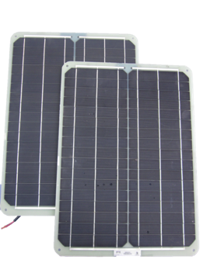
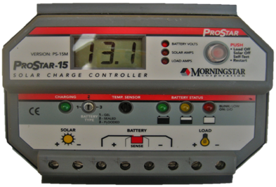
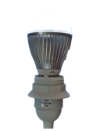





SOLAR ELECTRIC SYSTEM COMPONENTS
Solar Modules (PV)
Charge Controller
DC Loads
13.5
Regulates charging and discharging to battery
Appliances consuming electricity
Produces dc electricity
Inverter
Battery
AC Loads
Stores dc electricity
Converts dc electricity to ac

Slide 135







STAND-ALONE SYSTEM SIZE SPECTRUM
System Size
Small
Large
PV SYSTEM COMPONENTS | ‹#›

Slide 136



PV DIRECT – WATER PUMPING
Solar Module → DC Load
Simplest system
Fewest components
Only works when sunny
www.sunrotor.com
www.world.edu
PV SYSTEM COMPONENTS | ‹#›

Slide 137



PICO LIGHTING SOLUTIONS
Solar Module → Battery → Load
DC loads only
Limited amount of light per night
Affordable for households
www.dlightdesign.com
www.barefootpower.com
PV SYSTEM COMPONENTS | ‹#›

Slide 138




SMALL/MEDIUM STAND-ALONE SYSTEMS WITH DC LOADS
Solar Module → Controller → Battery → Load
DC loads only
Low voltage system
Good for system within short distances
PV SYSTEM COMPONENTS | ‹#›

Slide 139


MEDIUM/LARGE STAND-ALONE SYSTEMS AC LOADS
Solar Module → Controller → Battery → Inverter→ Load
Inverter allows ac loads to be used
More complex to design
Typically needs another charging source
www.myace.in
PV SYSTEM COMPONENTS | ‹#›

Slide 140

MICRO-GRID STAND ALONE SYSTEMS
Shared charging sources feed a centralized battery bank
Eliminates the need for utility power at the village level
http://www.makingitmagazine.net
PV SYSTEM COMPONENTS | ‹#›

Slide 141




GRID-INTERACTIVE SYSTEM SPECTRUM
System Size
Small
Large
PV SYSTEM COMPONENTS | ‹#›

Slide 142

GRID-DIRECT SYSTEMS
Largest worldwide market
Few components
Sells excess energy to the utility
Does not provide electricity during a utility outage
http://www.lifetimesolarenergy.com
PV SYSTEM COMPONENTS | ‹#›

Slide 143


DISTRIBUTED GENERATION GRID-DIRECT SOLAR
Individuals produce energy on-site for their own consumption
Excess energy is sold back to the utility
www.sierraclub.typepad.com
www.lighthousesolar.com
PV SYSTEM COMPONENTS | ‹#›

Slide 144

UTILITY SCALE GRID-DIRECT SOLAR
Centralized power plants produce energy from a renewable source
Photographer: Boris Horvat/AFP/Getty Images
PV SYSTEM COMPONENTS | ‹#›

Slide 145

GRID-TIED WITH BATTERY BACK-UP
Sells energy to the utility during the day
Stand-alone capability during utility outages
www.sethsolar.com
PV SYSTEM COMPONENTS | ‹#›

Slide 146

WE SHARE SOLAR SUITCASE
PV SYSTEM COMPONENTS | ‹#›

Slide 147

Estimating Energy Production for Grid Interactive Systems
1 panel = 250 W
$200 / panel
Sun hours 5
Efficiency is 77%
21st Avenue and 19th Street, Oakland

Slide 148
Estimating Energy Production for Grid Interactive Systems
1 panel = 250 W
$200 / panel
Sun hours 5
Efficiency is 77%
Oakland High
Exploratorium
California Academy of Sciences
Moscone Center
Ohlone Community College, Newark
Whole Foods 3000 Telegraph

Slide 149
Wiring a lighswitch box
Tuesday July 12th 2016
Learning Target:
To be able to wire a light switch box
Warm Up
Look at your wiring diagram. Explain in words how electricity travels from the battery to the expansion port (this is where the light switch box will go)

Slide 150
Day 12
8.15 - 8.30: Arrival and Breakfast
8.30 - 9.15: Community building
9.15 - 10.15: Solar engineering prep - The Cost of Efficiency
10.15 - 10.30: Break
10.30 - 11.00: Complete light switch wiring
11.00 - 12.00 Datalogging
12.00 - 12.30: Lunch
12.30 - 1.15: Troubleshooting
1.15- 1.45: Letter writing
1.45 - 2.15: Presentation Preparation
2.15 - 2.30: Break
2.30 - 3.15: College and Career
3.15 - 3.30: Closing reflections
Wednesday July 12
Community Building
Appliance Efficiency
Grid vs Stand Alone Systems
Sizing a system for your home
Wiring diagram
College and Career Panel

Slide 151
Price of Efficiency
Wednesday July 13th 2016
Learning Target:
To be able to compare efficiency of appliances in terms of price
Warm Up
How does the efficiency of a car affect the amount it costs to run?

Slide 152
Datalogging
Wednesday July 13th 2016
Learning Target:
To be able to explain what the information on the charge controller means
Warm Up
You have already practiced reading the information on the charge controller. Describe what information you have seen and how it has changed as you’ve been observing it.

Slide 153



FLOW OF ELECTRICITY - DURING DAY
13.5
BATTERY VOLTS
PV SYSTEM COMPONENTS | ‹#›

Slide 154
FLOW OF ELECTRICITY - AFTER BATTERY FULL
13.7
BATTERY VOLTS
PV SYSTEM COMPONENTS | ‹#›

Slide 155
FLOW OF ELECTRICITY - AT NIGHT
12.5
BATTERY VOLTS
PV SYSTEM COMPONENTS | ‹#›

Slide 156
Presentation Guidelines for Friday
Why did you build it and where is it going?
What do the terms voltage, current, power and energy mean?
How does electricity flow through the suitcase?
What does the charge controller show?
What have you learned about solar systems and their uses?
What skills have you been able to develop and practice during this program?
What have you learned about college options?
What have you learned about STEM careers?
Ensure that presentation time is split equally between group members.
Presentation is 10 minutes long.
All members must have notes to reference during their presentations.
All members must be ready to answer questions on all topics.
Use visual displays as you like - you can use up to 2 pieces of chart paper.

Slide 157
Letter Writing and Troubleshooting
Wednesday July 13th 2016
Learning Target:
To write a letter to the girls in Enoosaen and Brian in the Kibera slum (Nairobi)
To learn how to troubleshoot
Warm Up
These suitcases will go to the girls in Enoosaen or Brian in the Kibera slum. What would you like to tell them?

Slide 158
Troubleshooting Process
Step One: Determine what is not working.
Step Two: Hypothesize about what the problem is: . Is the light bulb broken, is it a problem about electricity reaching the socket; or has the battery worn out? Determine a test to see if the thing that is not working is faulty or if there is a problem in the system. E.g Plug light in a different socket; check to see if there is voltage at the socket.
Step Three: If the problem is with the system, NARROW DOWN where the problem is and then systematically check it using Multimeter, your eyes, the charge controller information displayed, or….
For example, if the socket is not working but the battery is connected to the charge controller (because the charge controller is on), then the problem is likely to be somewhere in the circuit between the charge controller and the socket.

Slide 159
Day 13
8.15 - 8.30: Arrival and Breakfast
8.30 - 9.15: Community building
9.15 - 10.15: Math Questions Practice
10.15 - 10.30: Break
10.30 - 12.00: Letter writing and presentation preparation
12.00 - 12.30: Lunch
12.30 - 1.15: Presentation Practice Run Through
1.15- 2.15: 4 Year Plans
2.15 - 2.30: Break
2.30 - 3.15: How to be a competitive applicant
3.15 - 3.30: Closing reflections
Thursday July 14
Community Building
Math questions practice
Letter Writing
Presentation Preparation
Practice Presentations
4 Year Plans
How to be a competitive applicant

Slide 160
Solar in your home
Thursday July 14th 2016
Learning Target:
To be able to size a solar system that would power your home.
Warm Up
If you were to design a solar system for your home, what information would you need? Write in your notebook.

Slide 161
Size a system for your home
Refrigerator 1-2kWh per day
Light bulbs incandescent - 60W
Fluorescent 15W
LED 6W
Desktop Computer 100W
TV 100 - 200W
Clothes dryer - 300 - 400W
Dishwasher - 1500W
1 panel = 250 W
$200 / panel
Sun hours 5
Efficiency is 77%
Extension
10W per square ft
Microwave - 1500W
Curling iron / hair straightener - 100W
Electric heater 1500W
Cell phone charger 4W
Gaming console 200W
Central AC 5,000W
More here

Slide 162
Solar in your home
Thursday July 14th 2016
Learning Target:
To prepare an OUTSTANDING presentation for tomorrow
Warm Up
What were the two things you and your group decided you need to work on when presenting? How can you think about these two things when preparing for the presentation?

Slide 163
Presentation Guidelines for Friday
Why did you build it and where is it going?
What do the terms voltage, current, power and energy mean?
How does electricity flow through the suitcase?
What does the charge controller show?
What have you learned about solar systems and their uses?
What skills have you been able to develop and practice during this program?
What have you learned about college options?
What have you learned about STEM careers?
Ensure that presentation time is split equally between group members.
Presentation is 10 minutes long.
All members must have notes to reference during their presentations.
All members must be ready to answer questions on all topics.
Use visual displays as you like - you can use up to 2 pieces of chart paper.

Slide 164
Practice Presentations 12.45 - 1.15
Each group must present for 10 minutes
Before presenting share your personal presentation goals with your partner in the other group
Group watching has 5 minutes to give specific feedback
201
Uriel Nancy
Alondra Brianna
Safiya Kimhort
Andy Cameron
Break Room
Monica Alexa J
Kimberly Alexa G
Qin Geoffrey
Downstairs
Ahn Christine
Juan Lupe
Victoria Josue
Christie Vien

Slide 165
Day 14
8.15 - 8.30: Arrival and Breakfast
8.30 - 9.15: Community building
9.15 - 10.15: Survey and Competency Checklist
10.15 - 10.30: Break
10.30 - 12.00: Summative Assessment and Presentation Practice
12.00 - 12.30: Lunch
12.30 - 12.40: Suitcase signing
12.40 - 1.30: Presentation Set Up and Final Practice
1.30 - 2.30: Presentations!
2.30 - 3.30: Celebration!
Friday July 15
Survey
Competency Checklist
Summative Assessment Review
Summative Assessment
Presentation Practice
Presentations!
Celebration!

Slide 166

Signing your suitcase
Your message will travel on a plane and over dirt roads to the final destination where it will be seen by all who use the suitcase!

